Slide 1


Basic Principles of Monitoring & Evaluation
A Guide to Coalition Building – Training slides

Slide 2
What we will do in this session
Review the definition of monitoring and evaluation
Review monitoring and evaluation principles for development projects
Monitoring and Evaluation for Advocacy: Approaches and Challenges

Slide 3
What is it: Monitoring and Evaluation

Slide 4

Monitoring
What is it:
Regular collection and analysis of information
What is it used for:
Track progress against planned activities
Verify compliance with standards
Identify trends and patterns
Adapting strategies
Make informed decisions for project/programme management

Slide 5
Evaluation
What is it:
The evaluation systematically and objectively measures the extent to which the project has achieved its intended objectives and the extent to which changes in results can be attributed to the project/programme
It includes the following 5 key elements:
Relevance
Efficacy
Efficiency
Impact
Durability
Notes:
Relevance: Relevance seeks to know if the project was applicable to the problem it intended to solve
Is the intervention appropriate to the priorities of the beneficiaries?
Are the objectives still valid?
Are the activities and outputs consistent with the project goal?
Efficiency:
Was the project completed on time?
Was the project delivered on budget?
Was the project scope delivered as planned?
Effectiveness: Effectiveness means the ability of the project to achieve the planned objectives
The extend to which the project objectives were achieved.
The factors that influenced the achievement of the objectives.
The factors that kept the project from achieving the objectives.
Impact: is about the positive and negative changes produced by the project, directly or indirectly, intended or unintended. This involves the main impacts and effects resulting from the project on the social, economic, environmental and other development indicators in the target group of beneficiaries.
What has happened as a result of the project?
What real difference has the project made to the beneficiaries?
How many people have been affected?
Sustainability is concerned with measuring whether the benefits of an activity are likely to continue after the project has ended. When evaluating the sustainability of a project, it is useful to consider the following questions:
• To what extent did the benefits of the project continue after the end of the
project?
• What were the major factors which influenced the achievement or nonachievement
of sustainability in the project?

Slide 6
Difference between Monitoring and Evaluation
​ | Monitoring​ | Evaluation​
Frequency​ | Periodic, regular​ | Periodic, episodic​
Main function​ | Monitoring, supervision | Evaluation, analyse​
Main purpose | Improving efficiency, adapting the action plan | Improving efficiency, impact and future programs
Focuses on | Inputs and products, deliverables, processes | Efficiency, relevance, impact, efficiency, sustainability
Sources of information | Routine systems, field observations, activity reports, rapid evaluation | Same sources - questionnaires, studies, interviews ​
Led by | Project managers, volunteers, donors, supervisors | Program managers, donors, supervisors, external evaluators

Slide 7
Complementarity between Monitoring and Evaluation
Monitoring | Evaluation
Clarifies the objectives of the program | Analysis of why results were achieved or not achieved
Links activities and their resources to objectives | Assesses cause and effect between activities and results
Translates objectives into performance indicators and sets targets | Examines implementation processes
Regular data collection on these indicators, comparing actual results to targets | Explores unins anticipated outcomes
Reports progress to managers and alerts them to issues | Extracts lessons, focuses on significant achievements or potential of the program and offers recommendations for improvement

Slide 8
The project cycle

Slide 9


Project Cycle
Monitoring
Evaluation
Planning
Design
Learning
Ideation
Implementation
Notes:
The DME cycle, contains three basic components. There is the design component, the monitoring component, and the
evaluation component of the cycle.
In this model there is a tight relationship amongst these components. The design will create the documents and the plans
that are used to implement and monitor the project activities. The data collected during monitoring, provides information used
in the evaluation phase. The evaluation component in turn provides recommendations back into the design component that
can be used for future projects.

Slide 10
Results-based management (RBM)

Slide 11
RBM: what is it?
It’s a definition of realistic expected results, based on appropriate analysys
It includes an accurate identification of programme’s beneficiaries and development of programmes that meet their needs
It includes monitoring, based on appropriate indicators, of progress based on results and resources consumed
It comprises identification and management of risks, while taking into account expected results and required resources
It aims at increasing knowledge by learning from experience and integrating them into the decision-making process
It includes reporting on results achieved and resources used

Slide 12
Key elements of RBM
Theory of Change: The History of Change. How will the project, in its context and environment, achieve the expected objective and impact
Steps to Change: Link to the Advocacy Handbook
Result framework: A visualization of the result chain between activities, results and objectives
Logical framework: A table summarizing the activities under their relative results and objectives, as well as the indicators and assumptions of the project (several models exist with more or less information, depending on the use and the funder)

Slide 13
Results chain
General objective
Specific objective 1
Result 1.1
Result 1.2
Specific objective 2
Result 1.1
Impact
Specific objectives
Results
Result 1.2
Activities
Activity 1.1.1
Activity 1.1.2
Activity 1.1.1
Activity 1.1.2
Activity 1.1.1
Activity 1.1.2

Slide 14
Objectives and results

Slide 15
Example of the horse that is thirsty
 | Exemple | Remarques
General objective | Contribute to the conditions for the horse to be happy | Long term We contribute to it Impact indicators (usually macro)
Specific objective | The horse is no longer thirsty (drinks water) | Medium term Depends on the strength of our assumptions Effect indicators
Result | The horse has access to water | Short term (during the duration of the project) Deliverable Indicators
Activity | Building a water fountain | Process indicators
Resources | Building materials of the fountain Labour force | Resource tracking (management)
Changes: Tracking goal achievement
Implementation:
Process tracking

Slide 16
Indicators

Slide 17
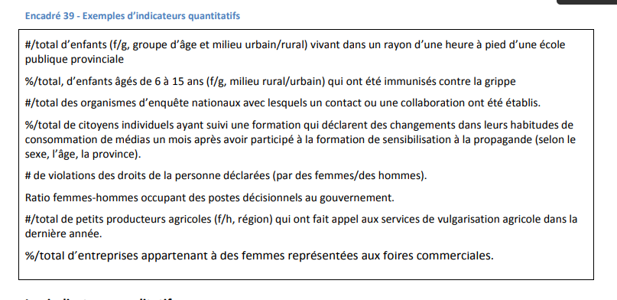
Indicators: Quantitative
Specific Measurable Acceptable Realistic Time-bound
Source: Global Affairs Canada - Managing for Results in International Assistance Programs https://www.international.gc.ca/world-monde/assets/pdfs/funding-financement/results_based_management-gestion_axee_resultats-guide-fr.pdf

Slide 18
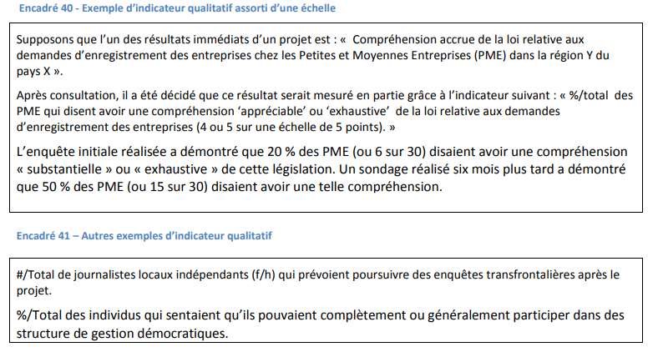
Indicators: Qualitative
Specific Measurable Acceptable Realistic Time-bound
Source: Affaires mondiales Canada - La gestion axée sur les résultats appliquée aux programmes d’aide internationale https://www.international.gc.ca/world-monde/assets/pdfs/funding-financement/results_based_management-gestion_axee_resultats-guide-fr.pdf

Slide 19
Monitoring and Evaluation Framework

Slide 20
Example of a Monitoring and Evaluation Framework
Definition of the Indicator | Baseline and target | Source | When | Responsible person
What do we measure? | What is the initial value of this indicator and what is the value we hope to achieve | What is the data source for this indicator? How are we going to measure it | When and how often will we measure this indicator? | Who will collect the data
Evaluation | Data | Methodology / source | When | Responsible person
Type of evaluation (e.g. mid-term) | What are we going to evaluate? Based on what data/indicators? | How we will carry out the evaluation | When and how often will we measure this indicator? | Who will collect the data
Notes:
Takes the logical framework but adds other indicators as well

Slide 21
M&E for advocacy

Slide 22
What are the challenges for advocacy M&E?
The M&E process is continuous, and it affects the whole cycle of your project/activity. A similar approach can be used to monitor your advocacy as well.

Slide 23
M&E for Advocacy
It’s similar to the Monitoring and Evaluation of a project
The difference is in indicators, how the progress is measured and how the approaches are evaluated
Advocacy is often very complex and is the result of several contributions which makes it hard to monitor
Decision-makers can sometimes be ‘adversaries’, which can complicate data collection and the objectivity of assessments

Slide 24
How do we follow up on our advocacy?
Track and measure intermediate outcomes
Document your activities and have multiple data sources
Using policy experts as a source of information

Slide 25
Checklist for Monitoring and Evaluation for Advocacy
SMART Advocacy Goals
Intermediate long- and medium-term objectives
Milestones (Important for Advocacy)
SMART Indicators
Data collection methods
Baselines
Targets
Activities and logic of intervention
Data analysis and reporting
Journals and reflections
Evaluation

