Slide 1

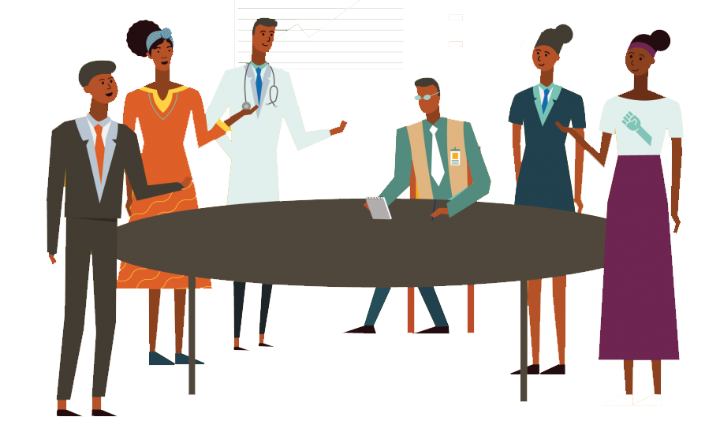
Planning your Advocacy Communications
A Guide to Coalition Building – Training slides

Slide 2
Advocacy and Communication
Advocacy is all about influencing and persuading but this will not happen unless advocates are able to communicate their ideas effectively
The quality and effectiveness of advocacy is dependent on the strength of communications.
Effective advocacy communications must be intentionally designed to drive advocacy goals.
Advocacy communications must be held to equally rigorous standards and measurement.
Bolstering advocacy communications capacity will be a critical step toward fully realizing our advocacy goals.

Slide 3
What is the relationship between Communications, Advocacy and Accountability?
Communication
Advocacy
Accountability

Slide 4
When choosing the communications for your advocacy​
What is the best format/way for this message to reach your audience? ​
What content do you plan to cover?​
How will this look like? ​
What are the actions and tasks to ensure production and development of material? ​

Slide 5
Using Visual Content to support our messages

Slide 6
What is visual communications?
Effective communication is not just about getting the message out, is also about the way the communication is presented.
Your message carries a story with it, try to tell that story in a way that resonates with the audience. Visual communications can help creating that story and communicating your message effectively.
Visual communications is one of multiple tools often used in advocacy campaigns to inform target audiences and facilitate change.
Forms of visual communications: photographs, video, graphics, infographics, cartoon.

Slide 7
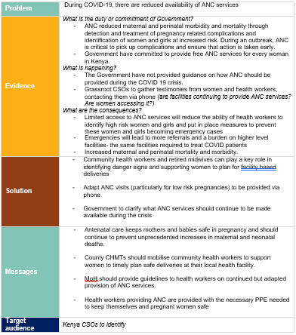
Looking at you Advocacy Message…
How do we use visual communication to convey this message?

Slide 8
Think about
What is the best format for this message to reach your audience?
What content do you plan to cover?
How will this look like?
What are the actions and tasks to ensure production and development of visual material?

Slide 9
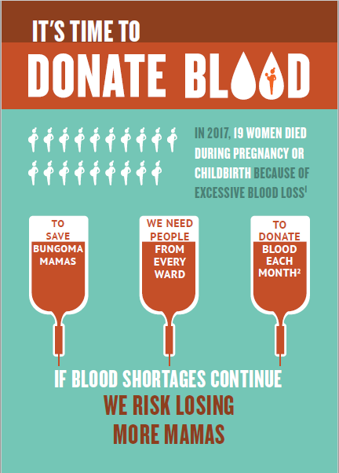
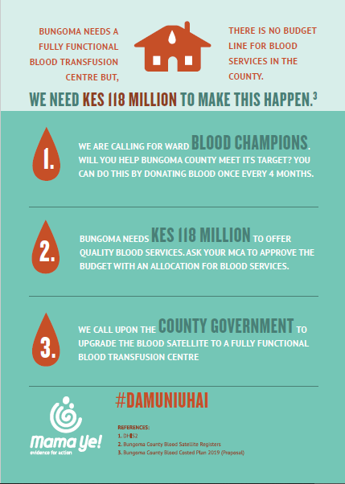
Visual Communication, an example
Solutions
Messages
Evidence
Audience
Problem

Slide 10
What tools?
Desktop-based apps: Power Point, Excel, Word
Online-based apps: Canva, Figma, Befunky, Crello

Slide 11
Some design tips
It takes time to build strong visual, so what you can do in the short-term?
Content, tone and style of language
Colours, Fonts, Imagery, Icons
Balance, Proximity, Less is more
Try to keep a long-term vision across the visual material you share

Slide 12
Keeping your visual communications consistent: what is branding?
In your visual communications try to keep consistency. Think about the idea of branding.
Brand
Trust
Credibility
Connection
Unity
‘The process involved in creating a unique name and image for a product in the audiences' mind, mainly through advertising your message with a consistent theme. Branding aims to establish a significant and differentiated presence that attracts and retains your target audience.’
Readapted from http://www.businessdictionary.com

Slide 13
Use of Digital Advocacy for Policy Influencing

Slide 14
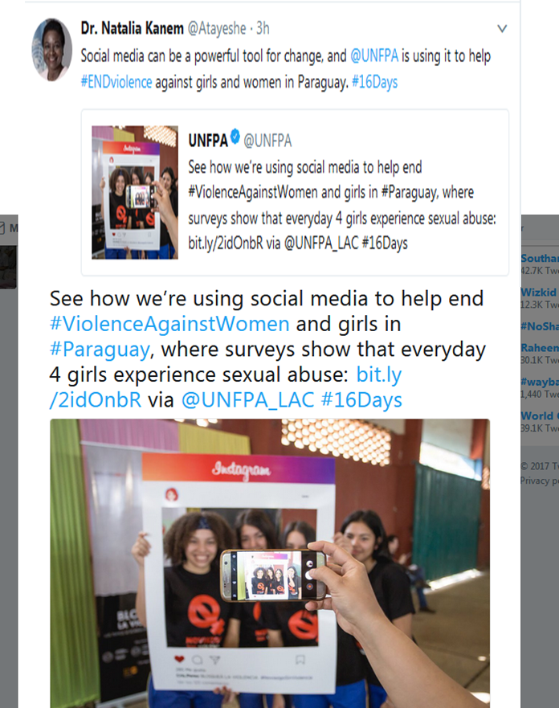
What is Media?
Media are forms of communication:
Electronic Media - Television and radio
Print Media - Newspapers, magazines and other forms of written printed materials
Digital Media - online newspapers and magazines, social media networks

Slide 15
Why Media?
For Agenda setting
Media agenda, Public Agenda, Policy or Political Agenda
To shape debate
An opportunity to change the way people talk about public problems
To Advance Policy
Using the media to put pressure on policy makers.

Slide 16
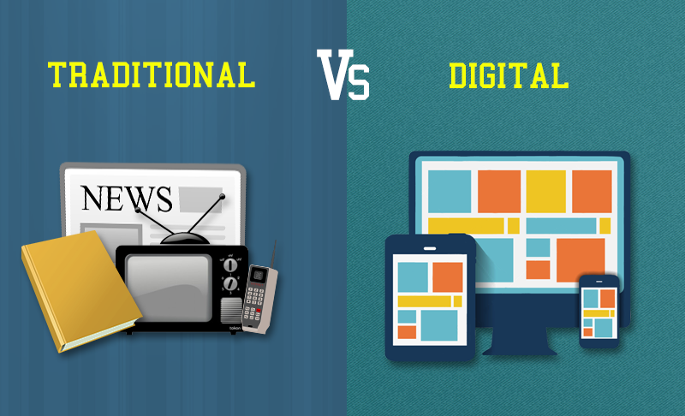
Comparing Traditional and Digital Media

Slide 17
Advantages of Digital Media
Why
Who
      Low or no cost
      Potential wide reach
      Instant sharing of information
      New opportunity to listen and monitor progresses
      Connect with almost every Policymakers
      Connect with almost every reporter
When
      Everyone!
      Almost every advocacy campaign can be beneficial if used strategically to reach out to target audience such as policymakers, relevant government officials, policy influencers etc.
      Anytime you want to engage people to take action
      You can join and participate 24/7
      However, timing is important to consider when carrying out specific campaigns

Slide 18
What is Digital Advocacy?
It is the use of digital technology (digital media) to contact, inform and mobilize a group of concerned people around an issue or cause requiring a policy change or action.
The purpose for digital advocacy is to mobilize people to take action to bring a change to a common need or issue.

Slide 19
When using Digital media for advocacy think about…
Is it appropriate to use digital media?
How would you use digital media for your advocacy campaign?
Which platforms would you use and why?

Slide 20
The use of social media for advocacy

Slide 21
From the Advocacy Message to the Social Media Message for Advocacy
Problem
Evidence
Solution
Audience
Message
Social Media Message
Notes:
Overview of the key elements of the process of creation of an Advocacy Message (5 coloured boxes). Once there is a message, then we have to readapt it to the social media context (light teal box). Here we will go through (see next slide):
It is important to note that this can be in more than one posts at a time but within the same frequency of messaging. At times the characters provided eg for twitter might not be enough for all this but it is important to keep the flow.

Slide 22
Tips when using social media to drive advocacy
Focus- hatch a goal that will make impact
Grab attention- be consistent in your approaches by using various strategies and platforms
Engage- make people connect with your goals
Take Action- empower others, enable and cultivate a movement
Know the do’s and don’ts of social media engagement
Do not only promote your cause- listen and monitor the activities of others, join others conversations (engage and interact)
Be sure to credit others when repeating information or quoting them.

Slide 23
Building a strong Social Media Presence
Content Plan: to stay on top of your advocacy and campaign objectives, develop a content plan or editorial calendar of the topics you will be posting, including:
Set your expected dates for desired outcomes.
Start by developing a skeletal framework of content, which can be updated as the campaign progresses.
Integrate and streamline all your digital and social media efforts while retaining an authentic presence on each platform. E.g., use opportunities to share key information across platforms easily.
Integrate all your online efforts with your offline efforts (physical engagement) to maximize success. Make sure to include your social media platforms (reference points) on printed materials and also promote contents on the printed materials online.

Slide 24
Building a strong Social Media Presence
  Learn how to use different social media platforms for different audience to achieve your Advocacy and Policy Influencing goals
  Follow policy makers at all levels of government on various social media platform, understand what policy makers are saying on social media- this will help you craft speaking points and messages you’ll need to communicate with them on your campaign issues.
  Try to build a community of advocacy coalitions through platforms such as Facebook or WhatsApp groups - this will increase your public pressure efforts and build grassroots support for your campaign.

Slide 25
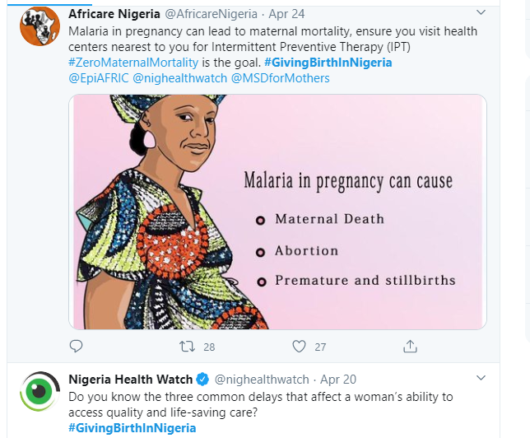
Examples of social media advocacies
Notes:
Eg. MakeNaijaStronger
GivingBirthinNigeria
EndSARS
FundNaijaHealth

Slide 26
Planning your communications​

Slide 27
Communicating strategically and politically​
What are the objectives of the piece of communication you have chosen to develop? ​
How is that specific piece of comms going to support your advocacy?​
When is this going to take place? And what actions are needed to achieve this? ​
What are the tasks that need to be done to make this happen? What content are you planning to cover? ​

Slide 28
Communicating strategically and politically​
What information do you need and in what format? (e.g., a PPT presentation, infographic / quick fact sheet)? ​
Be realistic about your skills and what you can do with the tools and skills you currently have? ​
Remember that the message will have to be readapted to each of these platforms​
What is the commitment / action you expect? ​
How do you plan to measure and monitor the achievement ​
of these objectives? And by when? ​

Slide 29
Planning your advocacy communications
What​ | When​ | Content​
 |  | Activity​ | Process diagram and deadlines | Activity Manager
Meeting with the xxx on Zoom | 31/05/20​ | 1. Data sheet before 25/05/20 | 1. Brainstorming on content and structure by 15/05/20 | X, Y, Z​
 |  |  | 2. Revision of the copy and technical revision by 16/05/20 | X, Y, Z
 |  |  | 3. Design by 20/05/20 | Y​
 |  |  | 4. Final review by 23/05/20 | X, Y, Z​
 |  | 2. Presentation before 25/05/20​ ​ | 1. Brainstorming on content and structure by 15/05/20 | X, Y, Z​
 |  |  | 2. Presentation - Project for 20/05/20 | Y, Z​
Question / Twitter enquiry with other SC members | 06/06/20​ | 1. Messages and questions for social media | ​ | ​
 |  | ​ | ​ | ​
Activity 3​ | ​ | ​ | ​ | ​

