Slide 1
Establish the Health Financing Context
Training Slides

Slide 2
OBJECTIVES
These slides will help you to:
Understand what Universal Health Coverage is
Be able to define key concepts related to health financing
Identify key indicators that can help you to establish the health financing context

Slide 3
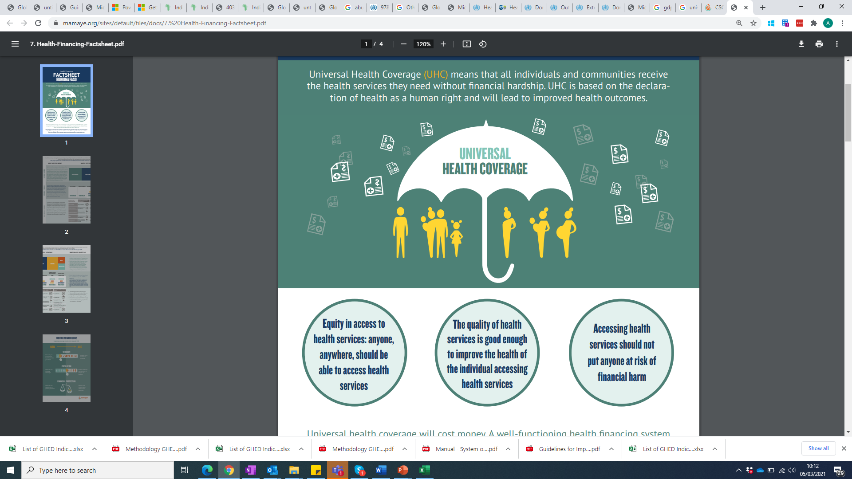
What is UHC?
Universal Health Coverage (UHC) means that all individuals and communities receive the health services they need without financial hardship. UHC is based on the declaration of health as a human right and will lead to improved health outcomes.

Slide 4
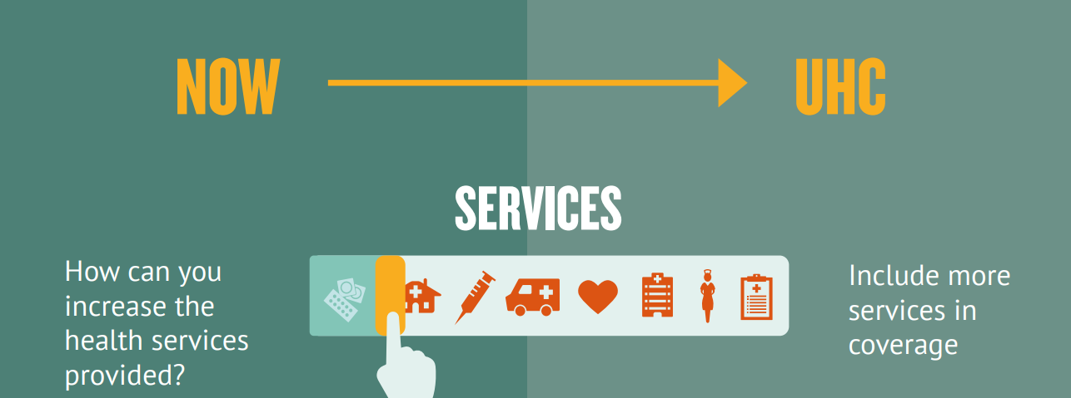
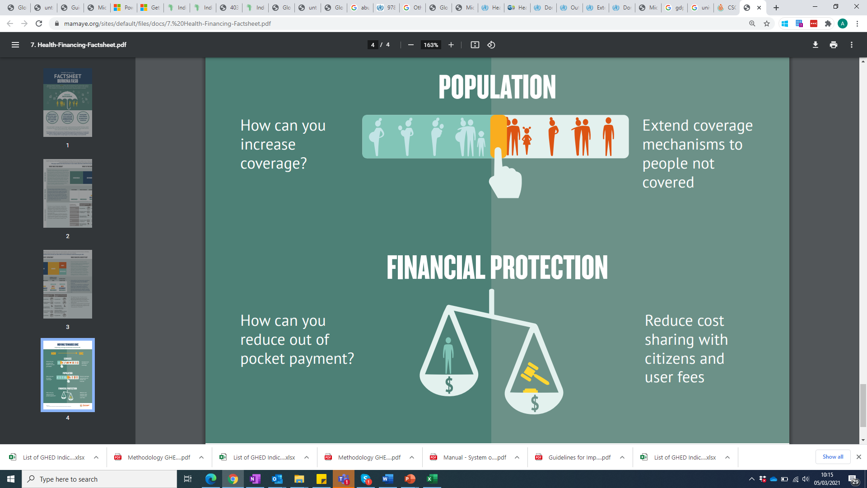
How can you move towards UHC?

Slide 5
3 key concepts: Revenue Raising
To deliver health services, money has to be raised from different sources.
In each country, a combination of sources will pay for health services:
  Government: This means health is paid for by taxes and revenues.
  Households: Households might contribute to insurance schemes or they may pay for services out of pocket. When they pay out of pocket, it can lead to households unable to afford care and exposed to financial shock.
  Employers: Employers might contribute to insurance schemes for their employees
  NGOs: NGOs may choose to subsidise selected health services for some citizens
  Donors: Donors can contribute funding to Government, health facilities, NGOs and directly to citizens (such as through voucher schemes)

Slide 6
3 key concepts: Resource Pooling
The way money is pooled matters
The smaller the number of pools, and the more people are enrolled in a single pool, the more the financial risk is spread, reducing the burden that any one citizen would have in paying for health care.
Consider this example to understand risk pooling:
  If you save money and put it in your own pot, you can only spend what you have saved.
  If you save money and put it in a pot with people in your community, you can spend what the community has saved.
  If you save money and put it in a pot with people across your country, you can spend what the country has saved.

Slide 7
3 key concepts: Purchasing Services
Purchasers can be a Government, a government agency, or a separate institution or company.
Those purchasing health services should do so strategically- using evidence, priority setting, and plans to inform their spending decisions.
If purchasers are buying on behalf of a large pool (with a big pot of money), they hold more negotiating power.
Purchasing from private for profit and private not for profit provide opportunities for regulation, incentivising providers to maintain a certain standard of quality of care.

Slide 8
Why establish the health financing context?
It gives you an indication of how much needs to be done to continue to move towards UHC in a sustainable way (e.g. relying on domestic, rather than donors to support)
It tells you to what extent Government have met their commitments so far
It provides insights into the opportunities for strategic advocacy, allowing you to focus in on the key issues, explore further, and advocate to the right people on key bottlenecks that are hindering progress towards UHC

Slide 9
Key indicators to establish the context
Indicator | What does it mean?
Domestic General Government Health Expenditure as % Current Health Expenditure | The share of overall current health expenditure that is from domestic government spending.
Voluntary Health Insurance as % of Current Health Expenditure | The share of overall current health expenditure that is from voluntary (not compulsory) health insurance contributions.
Out of pocket as % Current Health Expenditure | An estimate of how much households spend on formal or informal fees at the time of using health services, or as co-payments, when their health insurance or government funding does not cover the full costs of care. This is an indicator of whether people in your country are protected from the risk of getting into poverty or debt as a result of health expenditure.
External Health Expenditure as % Current Health Expenditure | The share of total current health expenditure that is financed by external sources, such as overseas development assistance.
Domestic General Government Health Expenditure (GGHE-D) as % Gross Domestic Product (GDP) | Describes public expenditures on health as a share of the economy as measured by dross domestic product (excluding external grants and capital expenditure). GDP is the monetary value of all goods and services produced in a country in a given period
Domestic General Government Health Expenditure (GGHE-D) as % General Government Expenditure (GGE) | Indicates the share of the total government budget that is allocated to the health sector, excluding services that are funded by external grants, even when they flow through government.

Slide 10
Advocating for Universal Health Coverage
E4A Coalitions established the Health Financing context as part of their political economy analysis. This has given them a strong evidence base to identify strategic ways to advocate for UHC in their countries.

Slide 11

Advocating for UHC

Slide 12
Next Steps
These slides are designed to give you an introduction to establishing the health financing context in your country
Now that you have the background, we recommend you use the Establish the Health Financing Context tool which accompanies these slides
This will help you to inform your advocacy efforts to accelerate progress on UHC.

