Slide 1
Plan health budget advocacy
Training Slides

Slide 2
OBJECTIVES
These slides will help you to:
understand why it is important to plan for health budget advocacy
identify the stages of planning for budget advocacy
learn how to develop your own health budget advocacy plan

Slide 3
Why is planning for health budget advocacy important?
Health budget decisions are made by multiple stakeholders.
Advocacy is most effective when we align advocacy engagements with government budget processes.
As advocates, our resources are limited. Planning helps us to prioritise key advocacy activities – those that will have the maximum effect.
Budget decision-makers and the financing context keep changing. Therefore, we should keep updating our strategies and tactics to continue to achieve results.

Slide 4
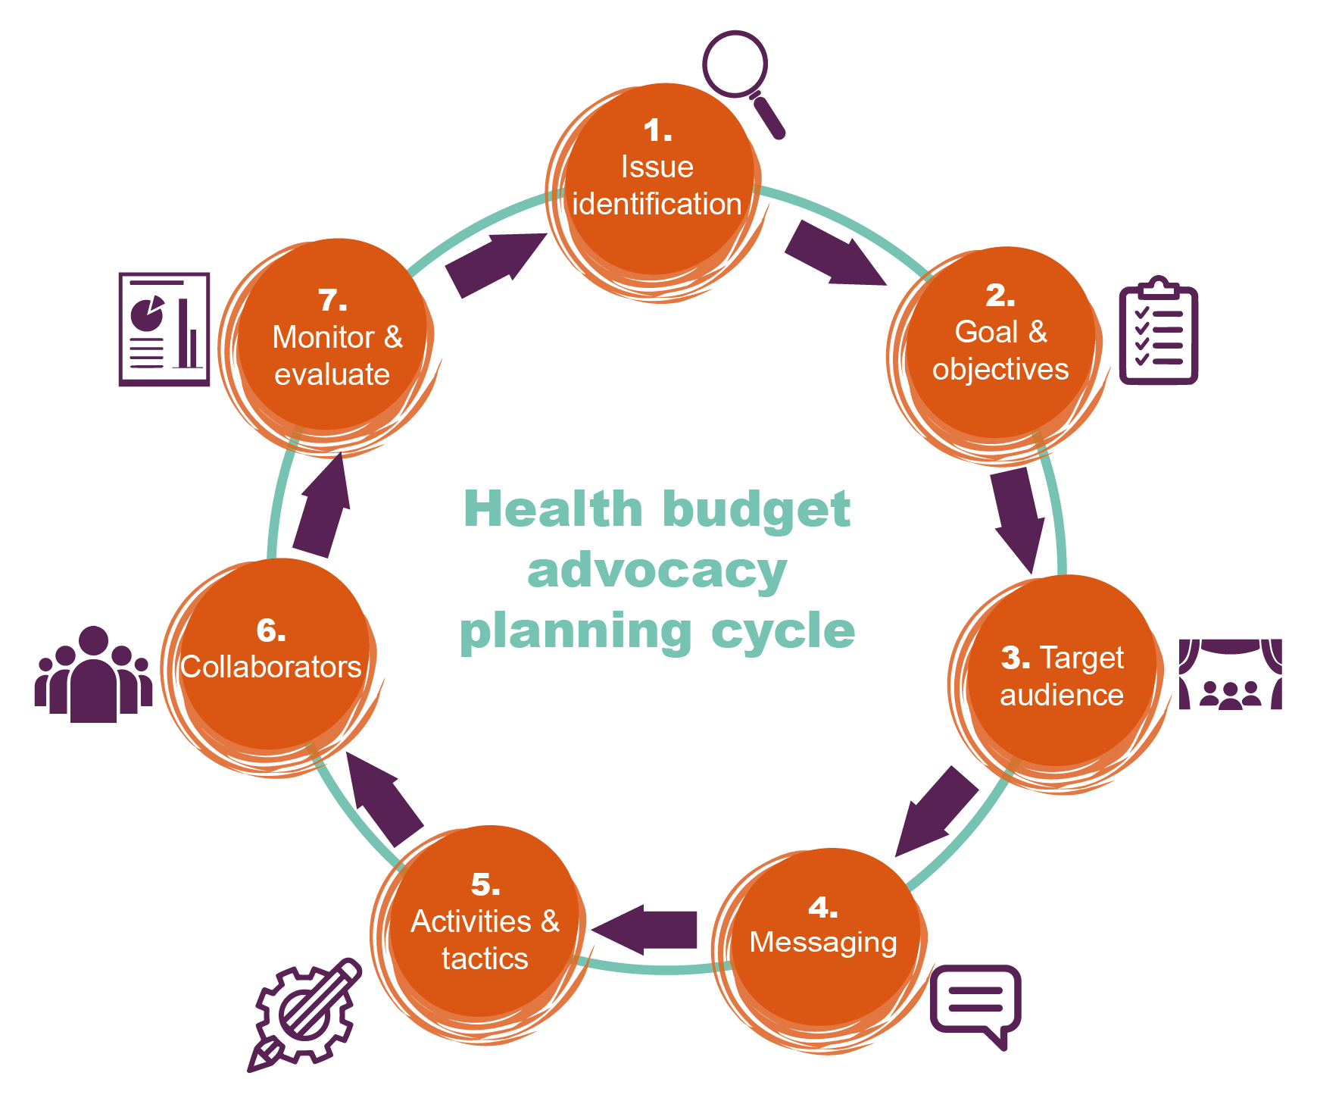
The health budget advocacy planning cycle
1.
Agree on the issue
7.
Monitor and evaluate
2.
Define the objectives
6. Coordinate with collaborators
3.
Identify the target audience
5.
Plan the activities
4. Develop the message

Slide 5
1. Agree on the issue
Work together to identify what budget problem is the most urgent.
There are so many health-related issues that require money. However, advocacy is more effective if you focus your efforts on a limited number of issues. You can use evidence to identify what issue should have highest priority.
Examples of issues that you could identify include:
  high maternal deaths
  high teenage pregnancy
  high malnutrition among infants.
We recommend that you then conduct a problem tree analysis to identify a specific cause of the issue. This cause can then be used as the focus of your advocacy. For example:
  low execution rates of RMNCAH budgets
  few women completing four antenatal care visits
  low blood availability in transfusing centres.
For more information on how to conduct a problem tree analysis, click here.

Slide 6
1. Agree on the issue
Key questions to ask:
  Is my issue affecting the communities that I represent? Which population groups are most affected?
  Is there evidence to justify my issue as a priority health issue?
  How can I justify the decision to focus on this issue rather than any of the other important issues?

Slide 7
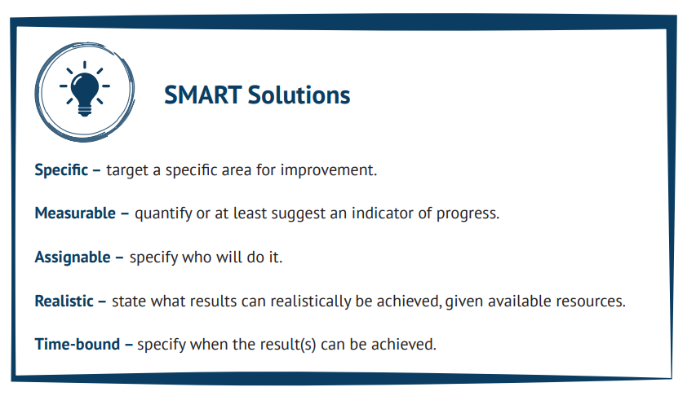
2. Define the objectives
After identifying the issue to fix, brainstorm to come up with solutions to the issue
For each solution, consider what you would need to see to know that the issue has been fixed
Identify what you objectives you can work towards to get to the solution. These objectives should be SMART:
SMART Objectives
For more information on how to develop SMART objectives, click here.

Slide 8
2. Define the objectives
Key questions to ask:
  What solutions am I proposing to solve the issue?
  How SMART are my objectives?

Slide 9
3. Identify the target audience
Map who holds what power to fix the problem by conduct a mapping who the decision makers are and what power they have to effect change
Consider who are the:
For more information on how to analyse stakeholders, click here.
Secondary audience
The network of people surrounding the primary audience who can influence them to act on your issue.
Primary audience
The key person who can enact the solution to fix the problem.
Prioritise the primary audience as the key decision makers who can fix the problem, and use the secondary audiences to influence the,
Assess whether your issue interests the audience or if you will need to make more effort to convince them.
Analyse your audience to understand what communication channels they use most.

Slide 10
3. Identify the target audience
Key questions to ask:
  Who needs to solve the problem?
  How easy is it to reach them?
  Who can influence their decisions?
  Do they have interest in the problem?

Slide 11
4. Develop the message
Decide whether your budget advocacy should be anchored on allocation or release or expenditure.
Budget advocates tend to stop at budget allocation during the budget-making process, but it can be valuable to go beyond this and to look at what is actually spent.
Tailor your message based on your identified audience – and obey the KISS principle: keep it short and simple!
To develop a health budget advocacy brief to present to stakeholders, click here

Slide 12
4. Develop the message
Key questions to ask:
  What action do I want the target audience to take to address my issue?
  What evidence do I have to use in my messaging?
  Which tools can I use to package my message?
  Is the message about budget allocation, release or expenditure on the issue identified?
  What action do I need the audience to take?

Slide 13
5. Plan activities
Consider what you need to do to engage with the target audience.
  How will your activities relate to the key dates of the budget cycle?
  What platforms are provided by decision-makers for your engagements?
  What do you need to do to reach target audiences in closed decision-making spaces?
Outline the resources you need at this stage so that your advocacy engagement is successful.
  What resources do you have and how much more do you need?
  Where can you get the resources you do not already have?
  Remember that resources are not just financial – they also include the people you have available, time and materials.

Slide 14
5. Plan activities
Key questions to ask:
  Do I know the budget process and key dates?
  What activities are happening at key dates?
  What are the key activities that I can implement to influence budget decisions on the priority issue?
  When do I want to implement them?
  What resources do I need to implement them?
  What resources do I have and what do I not have?
  Where can I get the resources I do not already have?

Slide 15
6. Coordinate with collaborators
To help you advance your objectives, it is important to find organisations to partner, coordinate and work with.
This is not only a way of mitigating resource gaps, but also strengths your collective voice.
Consider what you can learn from your collaborators and how you can partner in the future.
Examples of collaborators include:
  journalists
  civil society organisations
  faith-based organisations
  coalitions
  elected officials
  public servants.

Slide 16
6. Coordinate with collaborators
Key questions to ask:
  Who else is doing similar things to you?
  What resources do they have?
  How can you work together?
  How credible are they?

Slide 17
7. Monitor and evaluate
As you implement your advocacy interventions, you should track your progress against your objectives
Advocacy targets can be tricky to set and achieve. It is therefore important to identify SMART objectives.
Document all changes witnessed along the way, no matter how small.
The whole process is a cycle: we recommend that you look at what you are achieving and reflect on whether you need to change your tactics to achieve more success.
For more information on how to monitor your advocacy efforts, click here

Slide 18
7. Monitor and evaluate
Key questions to ask:
  How are my advocacy interventions performing?
  Which approaches are not working?
  What should be adjusted for better results?
  Do I still have the same target audience or have they changed?
  How can I maximise my best approaches?

Slide 19
Next steps
These slides are designed to support you in developing a health budget advocacy plan for your organisation or coalition.
Now that you have some tips on how to plan, we recommend you use the Health Budget Advocacy Planning tool to develop your own health budget advocacy plan. This will help you to make sure your advocacy is strategic.
Then, make sure you start advocating!

