Slide 1
Analyse budget performance
Training Slides

Slide 2
OBJECTIVES
These slides will help you to:
understand the key information sources for a budget analysis
know what calculations you can perform to do a simple analysis of budget performance (looking at allocation and expenditure)
know what questions to ask to interrogate your findings.

Slide 3
Why do a budget analysis?
  Carrying out an analysis on budget performance will enable you to:
  advocate for investment in health and RMNCH according to the budget
  hold government to account on political declarations, policies and commitments
  safeguard public resources against inefficient allocation and utilisation.

Slide 4
Definitions
Budget allocation is the amount of money that is planned and committed to be spent on a given area over a specific period of time.
Budget released is the money that is made available to a given entity (such as a state/county department of health or health facility) over the period.
Expenditure or utilisation refers to the money spent by an entity carrying out activities over the period.
Budget execution refers to the proportion of funds committed that were executed over the period
Money that is allocated is not always released. Money that is released is not always spent. To strengthen the accountability around the use of funds, we must ask why this is the case.

Slide 5
Sources of Information
Area of analysis | Source document and custodian
 | Kenya | Nigeria | Other countries
Allocation | County Program-Based Budget Respective County Department of Budget and Economic Planning; County Assembly; Treasury | Approved State Annual Budget Economic Planning Commission; Ministry of Finance; Ministry of Health | Look for documents titled 'Budget Appropriation Bill'; 'Budget Proposal', 'Budget Framework, 'Programme Based Budget' or 'Annual Plan'. These might be found on the Ministry of Finance website, devolved administration websites, or through CABRI.
Release | County Budget Implementation Review Report Controller of the Budget | Quarterly Budget Implementation Reports (produced at the federal level) Budget Office of the Federation; Ministry of Economic Planning at the state level | Look for documents titled 'In-Year Report', 'Mid-Year Review', ‘End of Year Report', 'Release and Expenditure Reports'. These might be found on the Ministry of Finance website, devolved administration websites, websites for the office of the auditor or accountant general, or through CABRI. This information can be difficult to access, so we recommend that you start by building trust with the custodians of this information.
 | County Annual performance Review Report Department of Budget and Economic Planning | Year End Report produced at the federal level Budget Office of the Federation

Slide 6
Sources of Information
Area of analysis | Source document and custodian
 | Kenya | Nigeria | Other countries
Utilisation | County Annual performance Review Report Department of Budget and Economic Planning | Ministry's Operational Reports Ministry, Departments and Agencies in Health | Look for documents titled 'In-Year Report', 'Mid-Year Review', End of Year Report', 'Expenditure Reports' 'Annual workplan implementation reports'. These might be found on the Ministry of Finance or health website, devolved administration websites, websites for the office of the auditor or accountant general, or through CABRI. This information can be difficult to access, so we recommend that you start by building trust with the custodians of this information. If this is not available to you, you can start to understand utilisation by going and speaking with your local facility: have they been able to use the funds they were promised? Did they use these according to the plan?
 | County Budget Implementation Review Report Controller of the Budget | Audited Report Office of the Auditor General

Slide 7
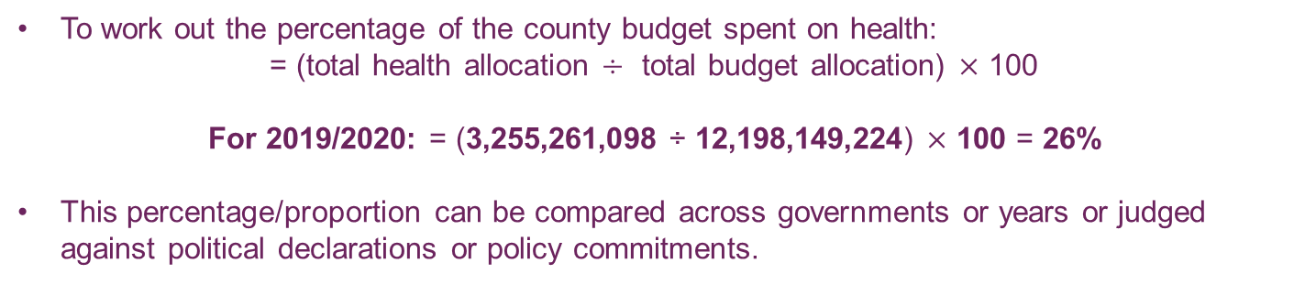
Allocation: Health budget as a proportion of total budget
This calculation matters because it can tell us how committed the Government are to prioritising health.
Example from Kenya | 2019/2020 (KES) | 2020/2021 (KES) | Source document
Total health allocation | 3,255,261,098 | 4,004,962,725 | Program-Based Budget
Total budget allocation | 12,198,149,224 | 11,835,998,884
To work out the percentage of the county budget spent on health:
= (total health allocation $÷$ total budget allocation) $×$ 100
For 2019/2020: = (3,255,261,098 ÷ 12,198,149,224) $×$ 100 = 26%
This percentage/proportion can be compared across governments or years or judged against political declarations or policy commitments.

Slide 8
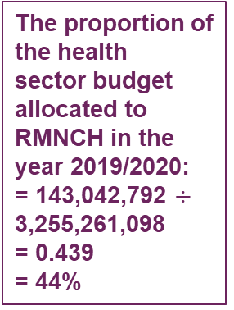
Allocation: RMNCH budget as a proportion of health budget
This calculation matters because it can tell us how committed the Government are to prioritising the issue we care about. In this case, RMNCH.
Example from Kenya | Programme | Sub-programme | Total budget (2019/2020) | Total budget (2020/2021)
1 | Curative and Rehabilitative Health Services | Primary Facility Services | 211,199,807 | 248,806,836
 |  | Hospital Services | 341,446,682
 |  | Program Total | 552,646,489 | 248,806,836
2 | Preventive and Promotive Health Services | Reproductive Maternal Neonatal Child Health (RMNCH) Services | 143,042,792 | 73,938,515
 |  | Immunization Services | 10,000,000 | 9,850,000
 |  | Nutrition Services | 20,000,000 | 4,645,197
 |  | Disease Surveillance and Control | 2,500,000 | 11,500,000
 |  | HIV Control Interventions | - | 121,756,023
 |  | TB Control Interventions | - | 3,737,840
 |  | Malaria Control Interventions | 2,000,000 | 22,244,212
 |  | Neglected Tropical Diseases Control | - | 900,000
 |  | Non-Communicable Disease Control | - | 2,400,000
 |  | Environmental Health, Water and Sanitation Interventions | 13,113,112 | 22,000,000
 |  | School Health Interventions | - | 6,324,000
 |  | Community Health – Level I Interventions | - | 45,845,000
 |  | Health promotion
 |  | Program Total | 190,655,904 | 325,140,787
3 | General Administration, Planning, Management Support and Coordination | Health Workers and Human Resource Management | 2,109,907,484 | 2,414,146,178
 |  | Construction and Maintenance of Buildings | 187,636,327 | 199,044,985
 |  | Procurement of Medicines, Medical and other Supplies | 205,000,000 | 10,460,000
 |  | Procurement and Maintenance of Medical and other Equipment | - | 36,479,364
 |  | Management and Coordination of Health Services | 6,414,894 | 25,721,117
 |  | Health Sector Planning and Budgeting, Monitoring and Evaluation | 3,000,000 | 31,526,600
 |  | Program Total | 2,511,958,705 | 2,717,378,244
Total | SECTOR TOTAL |  | 3,255,261,098 | 3,291,325,867
Budget allocation for RMNCH,
Financial Year 2019/2020
Total budget,
health sector,
Financial Year 2019/2020
The proportion of the health sector budget allocated to RMNCH in the year 2019/2020:
= 143,042,792 $÷$ 3,255,261,098
= 0.439
= 44%

Slide 9
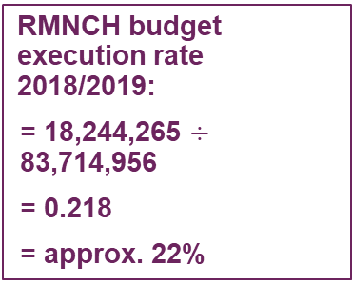
Budget execution: RMNCH expenditure as a proportion of RMNCH allocation
This calculation matters because it can tell us how much of the committed funds are actually spent according to the plan. This should be close to 100%.
Sub-programme | Total budget allocated (2018/19) | Total budget received (2018/2019) | Total budget spent (2018/2019)
Primary Facility Services | 171,252,940.00 | 171,252,940.00 | 111,429,522.00
Hospital Services | 360,974,600.00 | 383,724,600.00 | 46,180,038.00
Reproductive Maternal Neonatal Child Health (RMNCH) Services | 83,714,956.00 | 74,304,956.00 | 18,244,265.00
HIV Control Interventions | 4,440,442.00 | 3,177,652.00 | 499,000.00
TB Control Interventions | 2,392,465.00 | 1,926,150.00 | -
Malaria Control Interventions | 1,789,088.00 | 1,926,150.00 | -
Neglected Tropical Diseases Control | 25,909,590.00 | 45,836,000.00 | 5,562,200.00
Policy planning budgeting (MTEF dev) and M&E | 20,400,000.00 | 15,438,750.00 | -
Administration and support services | 4,866,245,849.00 | 4,825,173,413.00 | 839,890,997.00
Quality assurance standards and health research | 25,825,228.00 | 14,658,000.00 | 1,182,112.00
Coroner services unit | 1,957,500.00 | 33,125,000.00 | 537,060.00
Health commodities | 757,940,000.00 | 681,866,793.00 | 467,019,180.00
Capital project | 601,356,000.00 | 304,044,142.00 | 152,044,142.00
Total Health Budget
Budget allocation for RMNCH,
Financial Year 2018/2019
Total budget,
spent,
Financial Year 2018/2019
RMNCH budget execution rate 2018/2019:
= 18,244,265 $÷$ 83,714,956
= 0.218
= approx. 22%

Slide 10
Questions to interrogate your findings
How does the budget allocation compare with those in other regions, counties, countries or sectors?
How does the budget expenditure compare to previous years’ expenditures and to government commitments?
What is the budget execution rate for the priorities you are tracking? Can you think of what can be done to improve it?
Who has a role in improving budget allocation and expenditure for the priorities you have highlighted?
How could you advocate to them to improve budget performance?
For more information on how to conduct strategic advocacy, click here.

Slide 11
Next steps
These slides are designed to give you an introduction to conducting a simple analysis of budget performance.
Now that you understand the concepts and the calculations, we recommend that you look at the tool to develop your own analysis and dashboard.
This will help you to conduct and present analysis for discussion with decision-makers to influence action.

