Slide 1
Map the budget cycle
Training Slides

Slide 2
OBJECTIVES
These slides will help you to:
learn what the budget cycle is and why it matters
explore the four stages in the budget cycle
identify how you can engage in the budget cycle.

Slide 3
Key terms
Plan
A set of activities to be achieved in a given period of time.
Budget
An estimate of income and expenditure over a period of time
Expenditure
The use of income (spending) to purchase goods and services.
Budget execution
The implementation of the approved budget for a defined period of time.
Health financing
Includes resource mobilisation, allocation and distribution of resources for health.

Slide 4
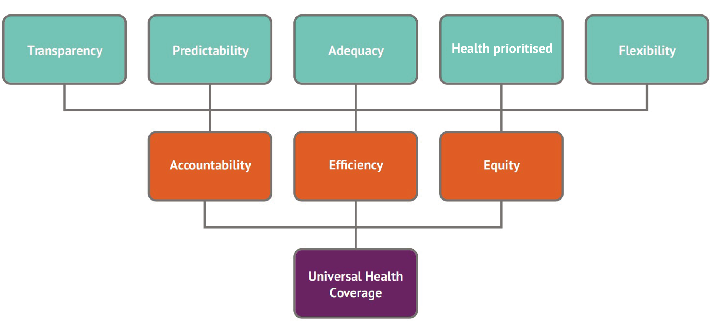
Principles: What is a good budget for the health sector?
For more information on how to identify these principles in your budget, click here.

Slide 5
The budget process
Budgets align to the aspirations of the nation (such as long and medium-term planning goals and aspirations such as the economic development goals at the national level, or the sustainable development goals at the global level).
In many countries, budgeting is guided by an overarching frameworks, such as the Medium-Term Expenditure Framework (MTEF).
Many modern budgets adopt a ‘program-based budget’ approach. This is where activities or inputs are grouped together into ‘programs’. Several programs make up a sector budget (such as the health sector).
Budgets are typically anchored in a legal framework, such as a Public Financial Management Act.

Slide 6
Use the budget cycle to know which stage to target
Different decisions are made at different stages of the budget process.
You should intervene before the decisions you want to change are made, not after.
Knowing which stage of the budget process you are in will help you
to be strategic in your advocacy efforts

Slide 7
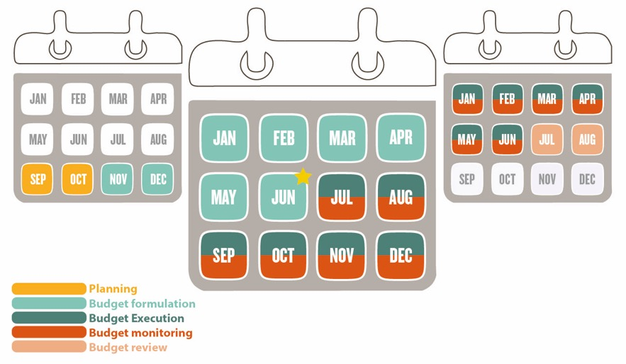
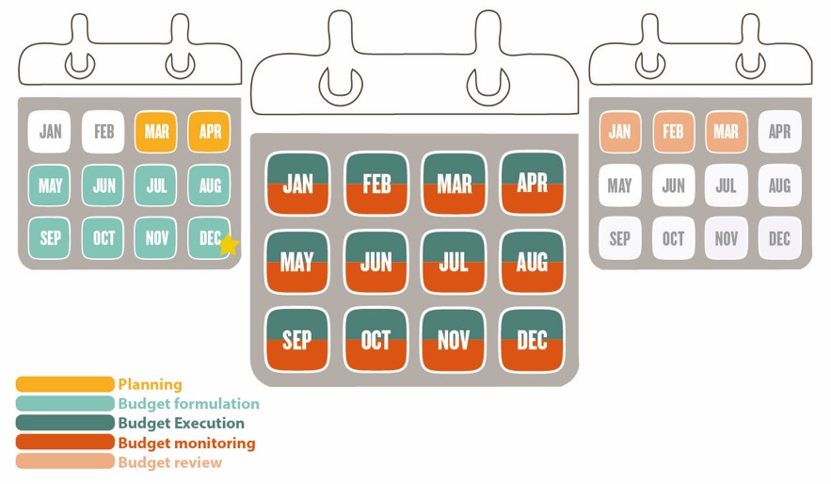
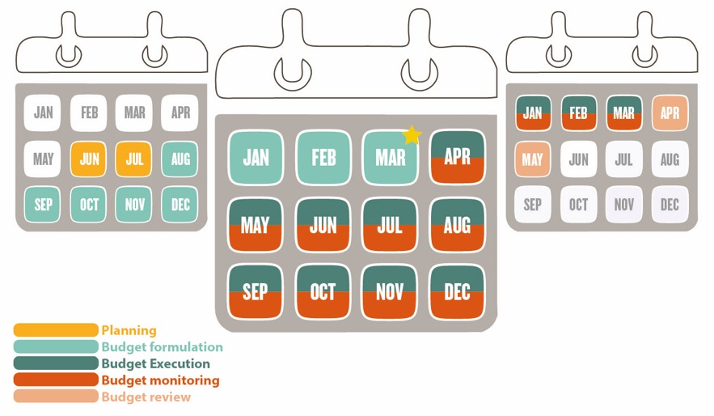
The budget calendar
Every country has a fiscal year. This can tell you when each stage of the budget process is happening and which months the current budget applies to.
Understanding which budget calendar applies is critical to ensuring that you engage at the right time with the right decision-makers.
Your country will have one of the following three budget calendars:
1. July to June
2. January to December
3. April to March
This means that the new annual budget will start in July of each year. Typically, this means approval of the budget will happen in February to June.
This means that the new annual budget will start in January of each year. Typically, this means approval of the budget will happen in September to December.
This means that the new annual budget will start in April of each year. Typically, this means approval of the budget will happen in December to March.

Slide 8
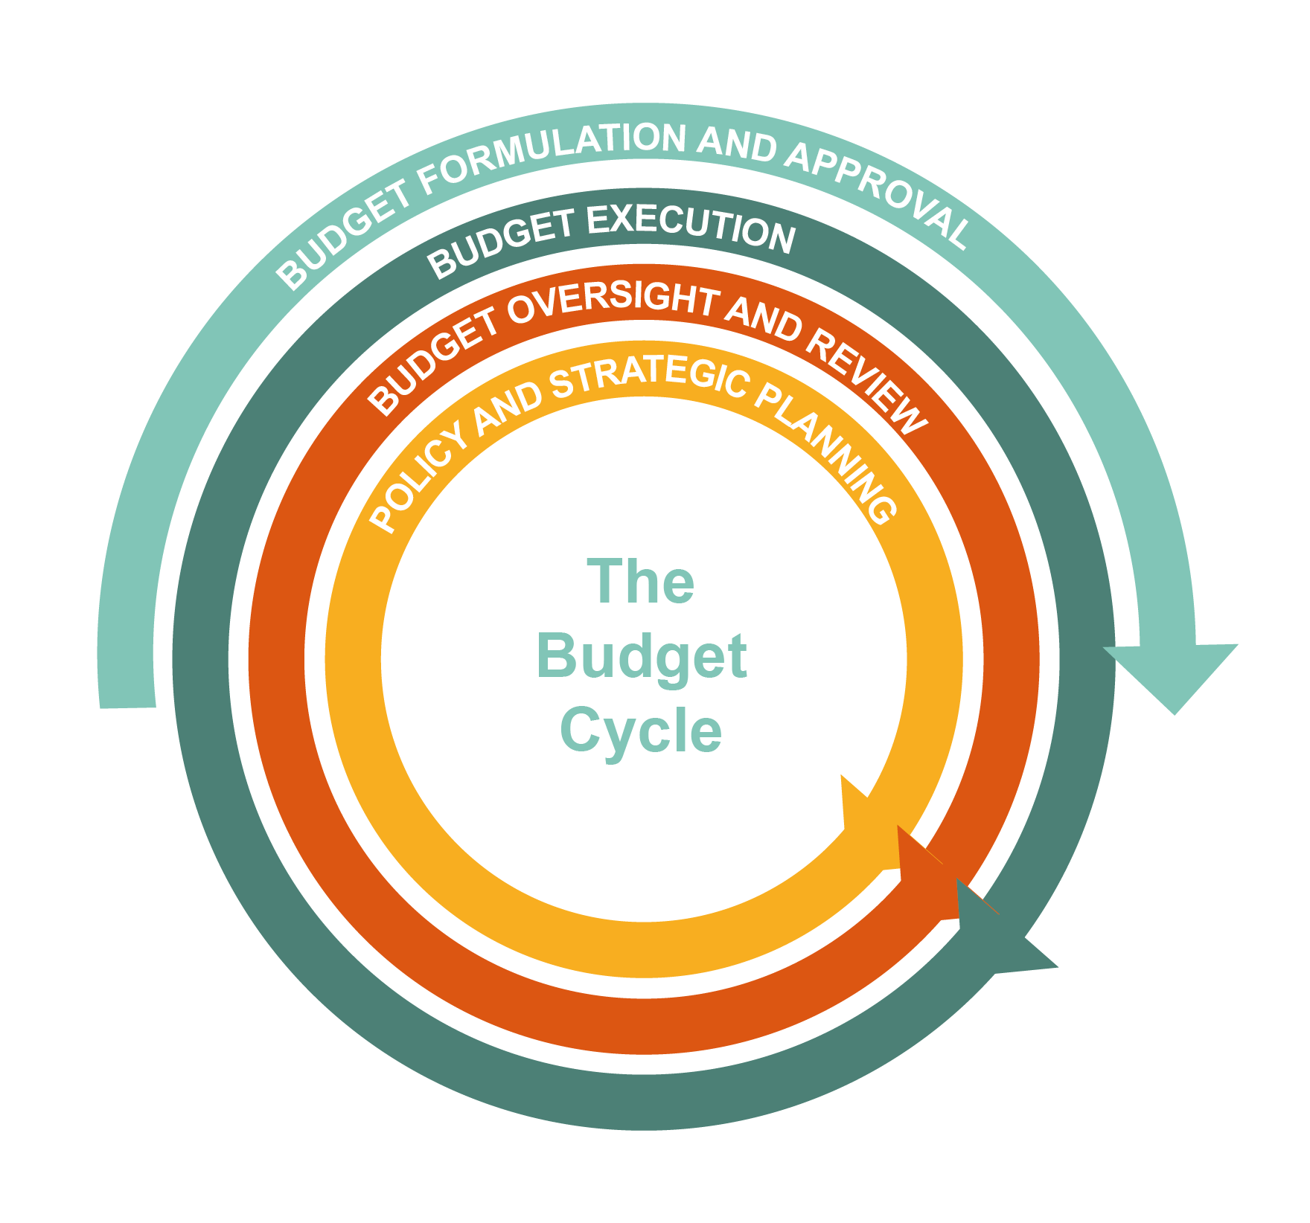
The budget cycle

Slide 9
Budget cycle steps
POLICY AND STRATEGIC PLANNING
Developing long and mid term policies and plans that set the direction for the health sector and highlight key priorities.
BUDGET FORMULATION AND APPROVAL
Developing annual plans and budgets including decisions and approvals on how funding is allocated.
BUDGET EXECUTION
Monitoring whether funds are raised, released and spent to implement commitments outlined in the budget.
BUDGET OVERSIGHT
Measuring whether public resources have been used appropriately, effectively, and efficiently in the previous financial year.

Slide 10
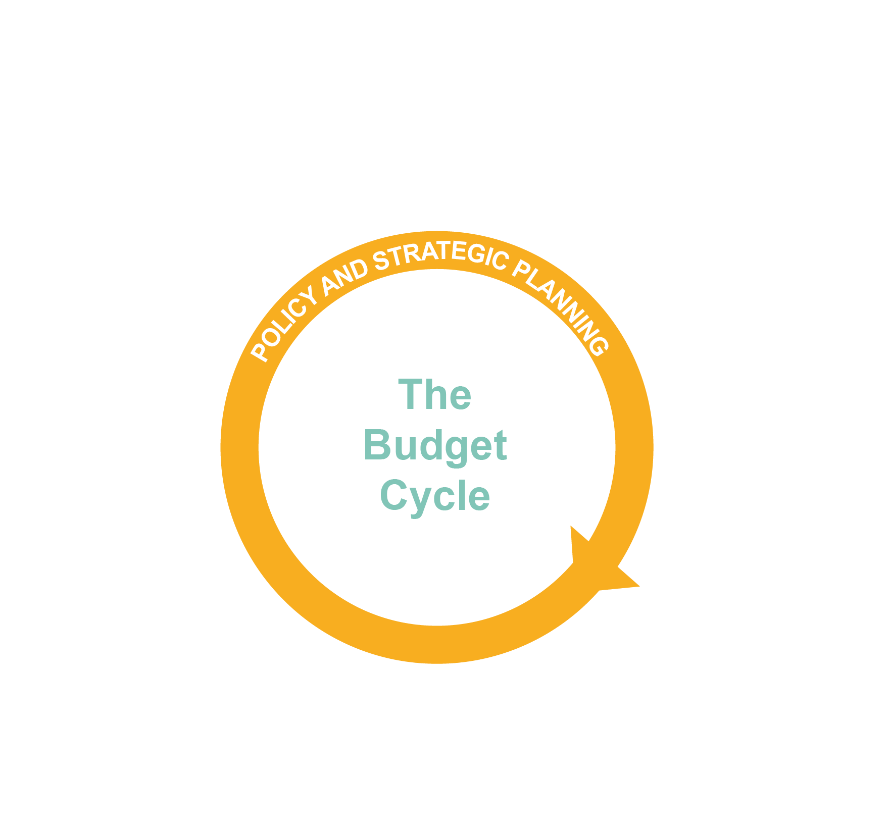
Policy and planning
Strategic and/or development plans are prepared
Annual workplans produced (identify who develops these in your region: for example, facility, district, region or country)
MTEF developed
Policies and plans validated
Policies and strategies can feel very long term. However, including your priority in these will give you more justification to then request they are included in annual plans and budgets in the future.

Slide 11
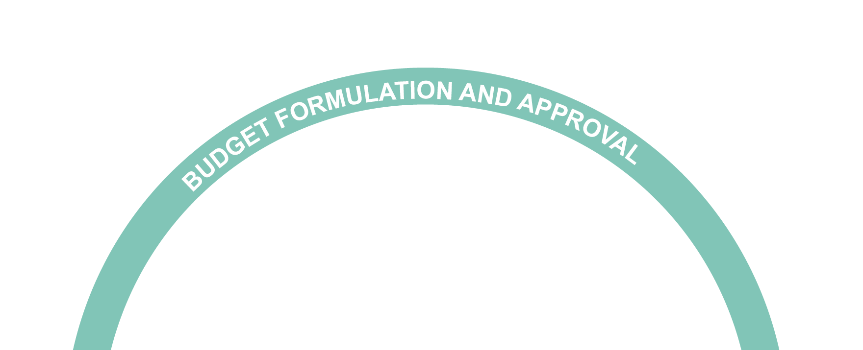
Budget formulation and approval
The country, region or sector looks at the income available for the year ahead
The country, region or sector allocates funding to inputs, activities, programmes or outputs
Approval by the legislature
The country, region or sector looks at what the budget envelope is for the year ahead
Approval by the executive
Notes:
Add in boxes to identify other decision making spaces with CSOs

Slide 12
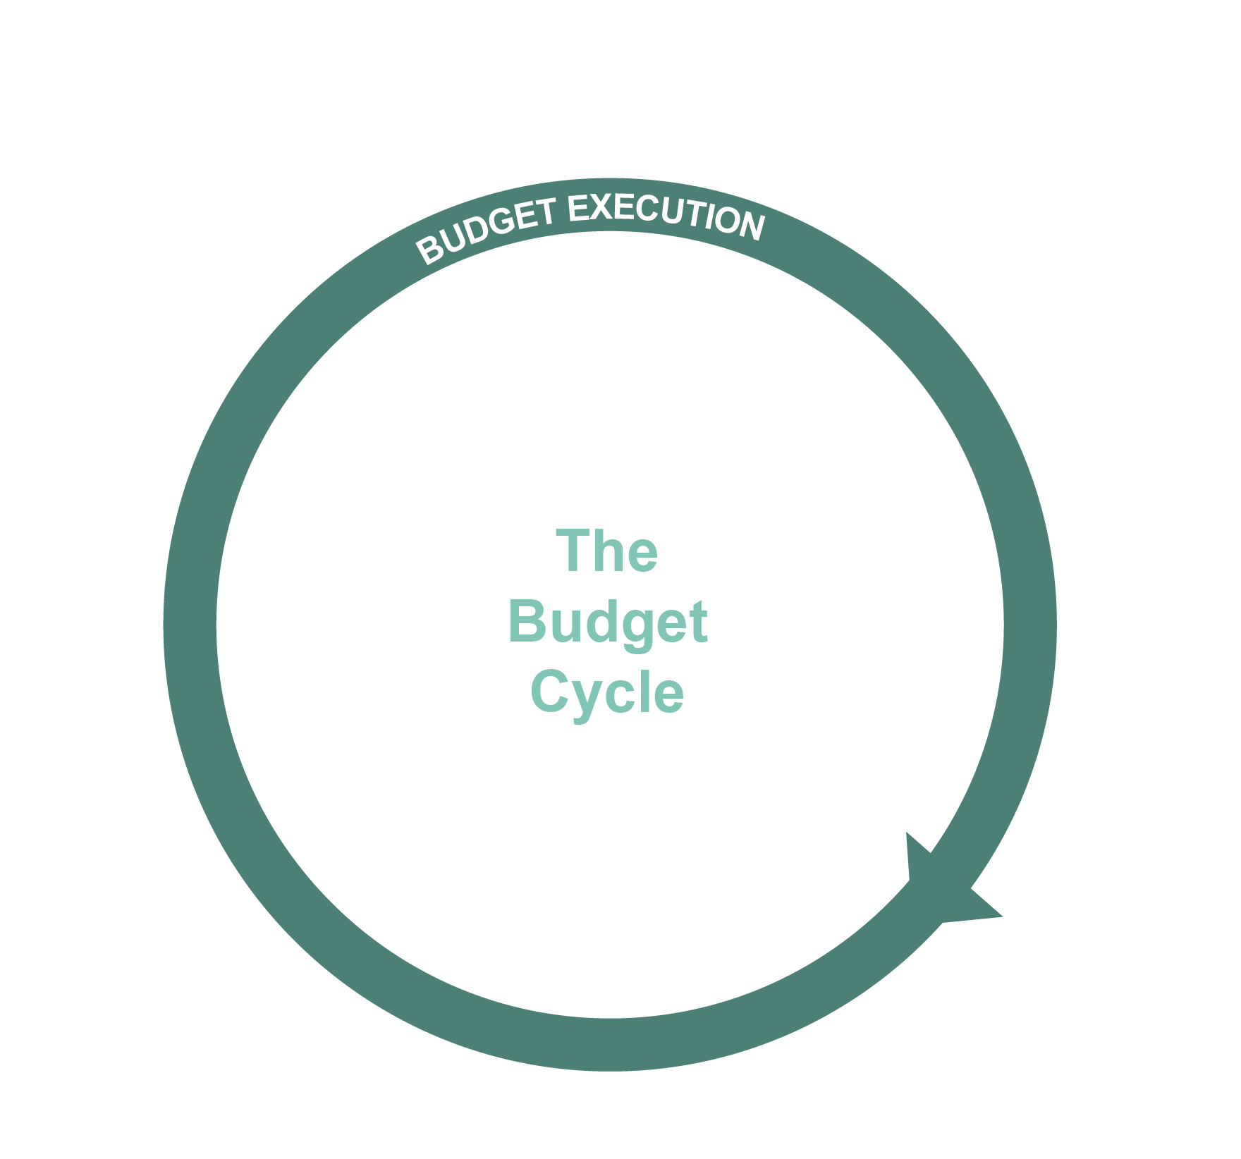
Budget execution
The approved funds are requested by spending departments
Departments/agencies produce in-year reports on spending of allocated funds
The approved funds are released to spending departments
Delivery of activities, programmes or outputs as per the budget and plan
If you think this might be an issue in your region, use the funding flow module to explore this further.

Slide 13
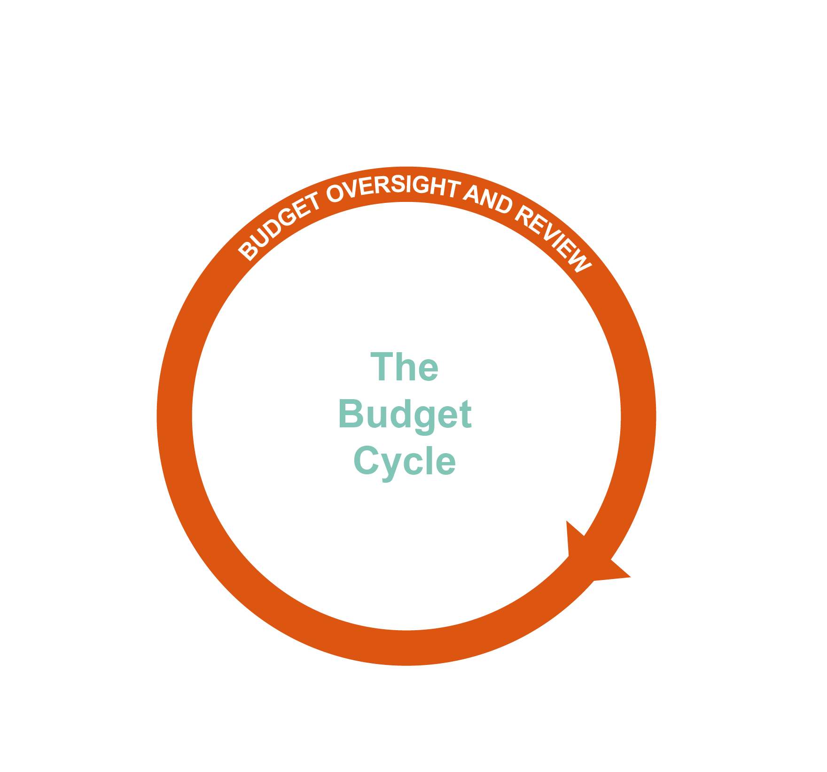
Budget oversight and review
Departments/agencies produce year-end reports on spending of allocated funds against their plan
Departments/agencies convene stakeholders to feed the findings from the performance review into future plans
An annual performance review might be conducted, providing a detailed assessment of budget performance and health sector performance

Slide 14
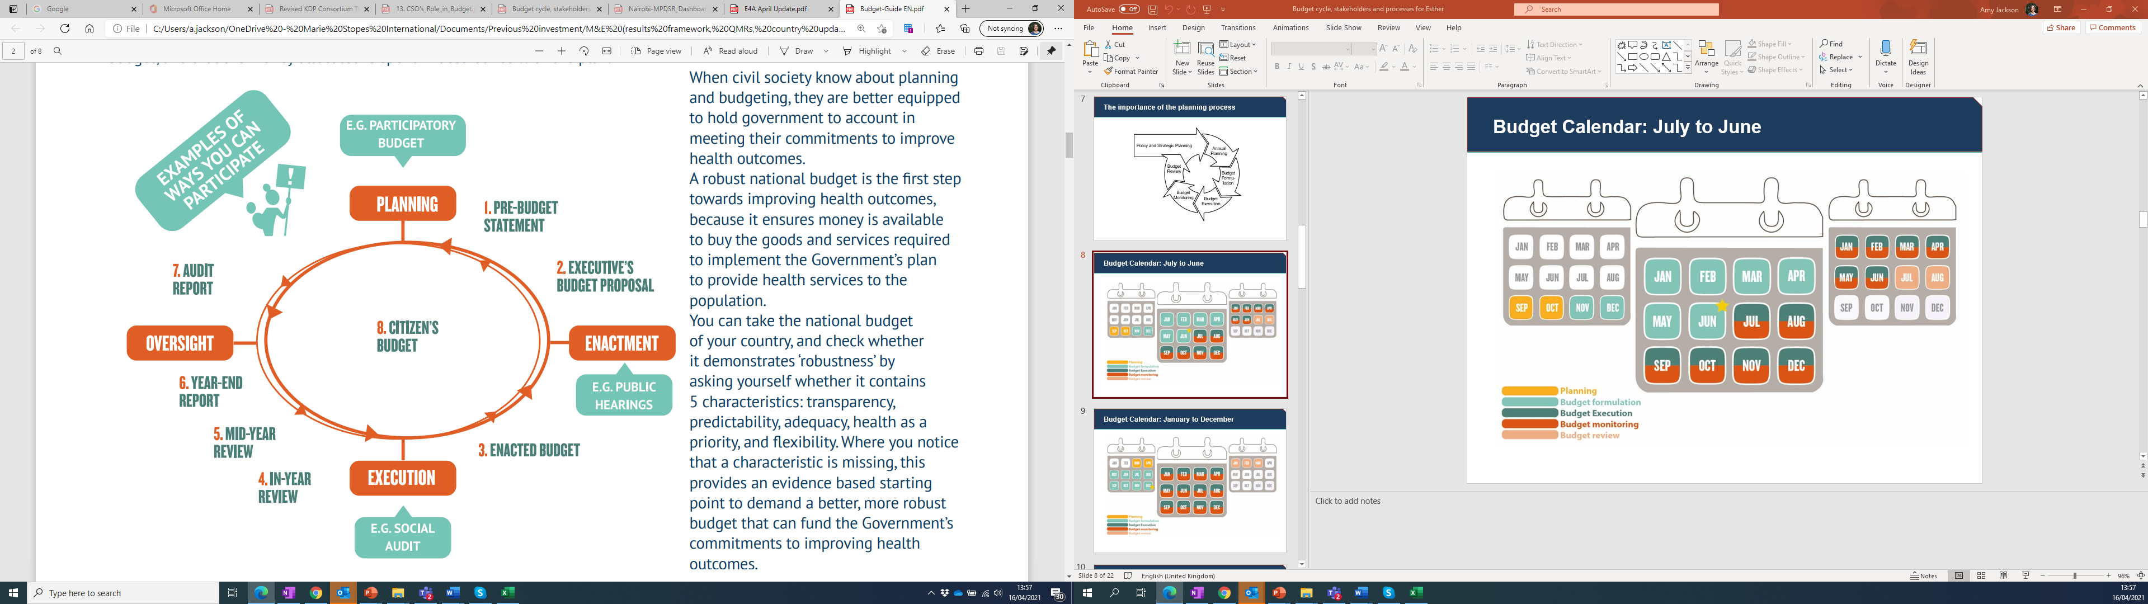
How can you engage in the budget cycle?

Slide 15
Consider who the main decision-makers in the budget making process are
Decision-makers at national level
Decision-makers at subnational levels
Central medical store
Provincial department of health
National budget
Reviewed and
approved by
the legislature
Ministry of Health
District government
Ministry of Finance
State/regional government
Ministries (local government, labour, social security)
Facilities/health workers
Development partners
CSOs and implementing partners
Who the decision-makers are and how much influence they have will depend on your country and its structure.
For more information on how to map the structure, click here.

Slide 16
Important dates and engagement opportunities
1. Policy and planning
ACTIVITY | ENGAGEMENT
Strategic planning | Engage in ensuring that priorities are included in policies and strategies. These will form the basis of future annual workplans and budgets.
Annual workplans | Engage in ensuring that priority activities are included in annual workplans. This will form the basis of the budget and determine which indicators will be tracked over the coming year.
Performance review of last year’s budget implementation to inform strategic planning for the coming year | Obtain the performance review report and note areas of improvement to inform future planning and implementation.

Slide 17
Important dates and engagement opportunities (continued)
2. Budget formulation and approval
ACTIVITY | ENGAGEMENT
Release of the budget-making process calendar of events (which stipulates what will be done and when) | Obtain the calendar, take note of important dates and milestones for preparation of engagement. If this is not released, try to access any public financial management documents as these may set out general dates for the budget cycle.
Development of the budget proposal | Engage the Department of health and the stakeholders responsible for economic planning to discuss gaps that they have identified and to lobby for increased allocation to priority areas.
Discussion and amendment of the proposed budget by the assemblies/parliaments | Seek audience with the legislature and use evidence to justify and advocate for increased allocation. Break down the need by the different constituencies represented in an assembly/parliament to make a direct case to each constituency’s representative
Approval of the budget | Obtain the approved budget to advise monitoring and oversight of execution.
For more information on how to do this through public participation, click here.

Slide 18
Important dates and engagement opportunities (continued)
3. Budget execution
ACTIVITY | ENGAGEMENT
Periodic budget implementation review within a financial year (e.g. quarterly) | Offer the departments of health and finance support in tracking the proportions of the budget released and spent against the budget targets. Obtain the quarterly budget implementation report to advocate for improved release, expenditure and timely implementation of activities against the annual plan. If this information does not exist, advocate for this information to be shared with civil society. Identify bottlenecks in release and expenditure within the year and engage the players involved to remove them.
For more information on how to present information on expenditure, click here.

Slide 19
Important dates and engagement opportunities (continued)
4. Budget oversight and review
ACTIVITY | ENGAGEMENT
Departmental review of the budget performance in the past year | Participate in the review process and engage with stakeholders on the report. Encourage policymakers to review both budget and health service delivery indicators, linking the two.
Annual budget audit carried out by independent bodies | Obtain the audit report and engage stakeholders on areas of improvement. This information can be used to advise planning and execution of budgets and to promote accountability for resources by public officials.

Slide 20
Next steps
These slides are designed to give you an introduction to the budget cycle.
Now that you know the stages of the budget cycle, we recommend you use the Budget Cycle Mapping tool to map how you can engage in the budget cycle in your context.
This will help to inform the timing of your budget advocacy efforts.

