Slide 1
Develop a health budget advocacy brief
Training Slides

Slide 2
OBJECTIVES
These slides will help you to:
explore how to make the case for investment in areas of health that are a priority
identify what data can help to make your case
go through an example expenditure brief to understand what yours can look like.

Slide 3
Making the case for investment in health

Slide 4
Linking financial data to health indicators
More money for health is only useful if it leads to better health.
To make the case for health investment to policymakers, link information on funding for health with the issues that policymakers might be interested in.
On the next slide, we present a continuum of care for a woman giving birth. It shows how health indicators and funding indicators can be used to make sure that all women can access the services they need.
While this is specific to maternal health, if you are interested in another area of health, you could map out the continuum of care for a patient within that area and consider what health and funding indicators will help to make the case.
Notes:
We might focus on specifics because that is what we can track, but important to note how our focus fits within the wider funding for RMNCAH

Slide 5











Linking financial data to maternal health indicators
Health workers (community health workers, nurses, midwives, doctors); commodities (contraception); and equipment, essential drugs and utilities (general maintenance of facilities); maternal and perinatal death surveillance and response (MPDSR)
Funding required for RMNCAH
Reproductive health, family planning (FP)
Antenatal care
Nutrition
Primary health care including community services
Comprehensive emergency obstetric care
Postnatal care
Mrs X has access to FP so can choose if and when to have a family
Mrs X accesses at least four high-quality ANC visits during pregnancy
During her pregnancy, Mrs X has access to the nutrition she needs to keep well
Mrs X attends a facility to deliver. The facility is equipped with antenatal documentation, a skilled birth attendant, and all commodities and equipment required for a safe delivery
In case of complication, Mrs X is referred to a higher level facility, equipped with everything required for a safe delivery
Mrs X and her baby access post natal care, where she is given FP post pregnancy and also nutritional advice
Continuum of care for good maternal health
Contraceptive prevalence rate
Number of women accessing one or four antenatal visits
% women with anaemia
Number of women having skilled birth attendant at delivery
Number of maternal and perinatal deaths
Number of women receiving postnatal care
Data to track RMNCAH
Notes:
Credit the WHO Mrs X video

Slide 6
Linking financial data to health data strengthens your ask
Questions to guide your advocacy asks
Sources of information
What is the problem or advocacy objective that you
want to address?
Discussions with CSOs and communities
Anecdotal evidence
What data demonstrates the importance of your ask?
Health outcomes, e.g. maternal mortality, perinatal mortality, teenage pregnancy
DHS, DHIS
Are the Government prioritising the problem or opportunity?
Data on the budget allocation
Annual plan and budget
Are the Government following through on
their commitment?
Data on the budget expenditure
Expenditure reports
If yes, is this making
a difference?
If no, are the Government receiving the funding?
Data on the budget release
Expenditure reports
If yes, why are they not spending it?
If no,
why not?
Interviews and informal discussions with officials and health providers
Anecdotal evidence
What else can be done to improve RMNCAH outcomes?
Health outcomes, e.g. maternal mortality, perinatal mortality, teenage pregnancy AND discussions with communities

Slide 7
Linking financial data to data on health strengthens your ask
There are not enough midwives in the county
At this point policymakers might ask: what can be done?
1. The region is not allocating enough to health.
2. The region is not spending the money it is getting. Action needs to be taken to ensure all funding allocated is spent.
3. If the region spends the money it has, it can increase the number of midwives and reduce maternal deaths.
Bring together collaborators (including government officials) to identify the bottlenecks to spending
Nurses/midwives density in the region is below the national average
OR
Maternal mortality is above the national average
Only 25% of allocated funds were spent;
execution rates are very low
Region has committed to allocate 15% of its budget to health
Region has allocated only 6% of its budget to health
Answer
Answer
Answer
Answer
At this point policymakers might ask: so what?
At this point policymakers may think: what happened to the funds allocated?
At this point policymakers may think: why is there such limited spending?
At this point audience may think: why does addressing these bottlenecks matter?
Key points for your advocacy

Slide 8
Developing the health budget advocacy brief

Slide 9
What is a health budget advocacy brief?
A health budget advocacy brief is a visually designed factsheet that links budget allocations and expenditure data with service delivery performance to make a compelling case on priority issues.
The brief combines graphical illustrations and narratives to provide insight on the data presented.
It is important to identify the priority areas, programme or indicators and gather all data relevant to each section of the brief before commencing the design of the brief.

Slide 10
Why are budget advocacy briefs important?
There is often limited time to interact with policymakers to deliver complex budget advocacy messages.
As a result, it is important to deliver information in a simple way.
Translating health financing information into more visual formats can help this situation. Therefore, we suggest using an expenditure brief.

Slide 11
This budget advocacy brief has six sections
Health profile: this shows high-profile data for the state or country, such as population, GDP per capita, proportion of health budget etc.
Budget allocation: identifies the budget allocated to priority programme areas, such as family planning, immunisation, nutrition, maternal and perinatal death surveillance response etc.
Budget expenditure: identifies the funds disbursed or spent (depending on what data is available) on priority programme areas.

Slide 12
This budget advocacy brief has six sections
Service delivery: presents service delivery performance data for the period under review, and illustrates efficiency by linking budget allocation to disbursed funds and services delivered.
Insights and ‘asks’: this is a summary of the top
four findings from the factsheet. The findings
are informative and explain the facts. The two ‘asks’
should target specific decision-makers with
specific, realistic actions.
The write-up: This is written on the back page of the illustrative factsheet. It translates the factsheet into a narrative for audiences that prefer reading.

Slide 13
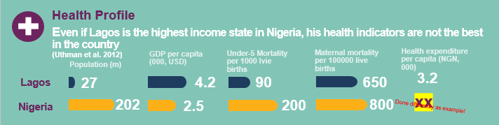
The health profile section: change indicators, or use numbers
This section contains a health profile of the region you are focusing on.
We suggest presenting data on high-profile indicators, such as GDP per capita, health expenditure per capita, maternal mortality, population etc.
Include in the section a sentence on the main insight
of data presented.
1. Add a sentence on the status of health indicators in your state.
2. Change the labels to represent your region and country.
3. Right click on the bar and select ‘Edit Data’. Input your data on population, GDP per capita, under-5 mortality and maternal mortality, and add the indicator as a number or percentage next to the charts.
4. Add in the currency and health expenditure per capita for your region.

Slide 14
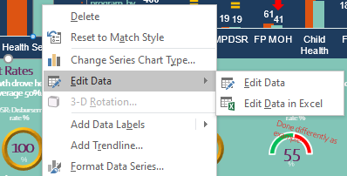
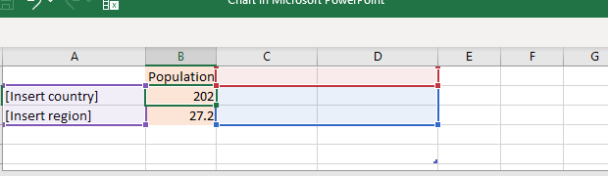
Editing values in bar graphs: population example
Select the bar graph, right click.
Select ‘Edit Data’.
Replace cells A1 and A2 with the country and region you want to focus on.
Click on ‘population’ cells (B2 and B3), type the new values into the shaded orange boxes, press enter.
Close the window and the information will automatically update.
In older PowerPoint versions, you may have to place the cursor on the little arrow beside ‘Edit Data’ and select ‘Edit Data in Excel’

Slide 15
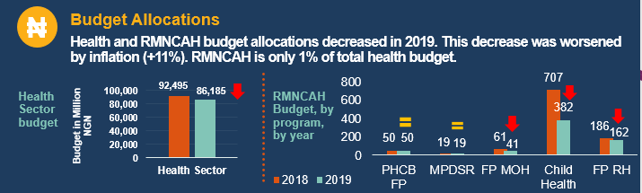
Budget allocation section
Present the health budget as a percentage of the overall budget and the RMNCAH budget as a percentage of the total health budget.
If possible, make a comparison between previous years and the current budget.
5. Add a sentence setting out the status of budget allocation in your region.
6. Right click on the bar and select ‘Edit Data’. Input your data on health budget allocation for this year and the previous year.
7. Right click on the bar and select ‘Edit Data’. Input your priority programme areas from the budget and the data on allocations for this year and the previous year.

Slide 16
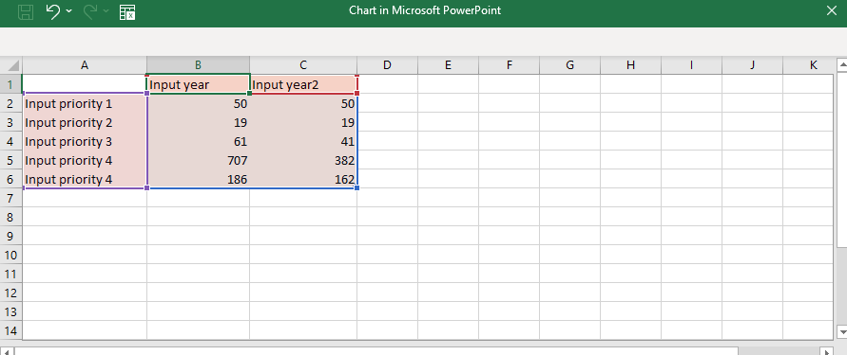
Editing values in bar charts: budget line example
In older PowerPoint versions, you may have to place the cursor on the little arrow beside ‘Edit Data’ and select ‘Edit Data in Excel’
Select the column graph, right click.
Select ‘Edit Data’. You’ll see this:
Fill in the shaded orange boxes: this includes adding your priority budget lines in column A and the years in review in columns B and C, along with the budget allocation data.
Close the window.

Slide 17
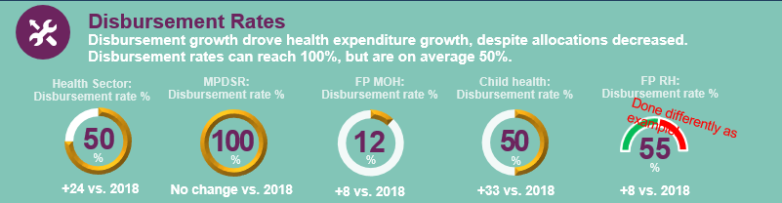
Budget expenditure section
Depending on available data, this section captures data on disbursements or both disbursements and expenditure.
Disbursement data shows how much is released by government for the programme being tracked. Expenditure data shows how much is spent. If the data is available, focus on expenditure.
In the example below, the graphs show disbursed funds as a % of allocated funds.
8. Change this to ‘Expenditure’ if you have the data available.
9. Add a sentence setting out the status of disbursement or expenditure.
7. Change this to ‘Expenditure’ if you choose to focus on expenditure rather than disbursement rates.
10. Right click on the doughnut and select ‘Edit Data’. Input your data on health sector disbursement or expenditure and allocation.
11. Right click on each of the other doughnuts and select ‘Edit Data’. Input your data on priority programme disbursement or expenditure and allocation. Make sure you also edit the heading accordingly!

Slide 18
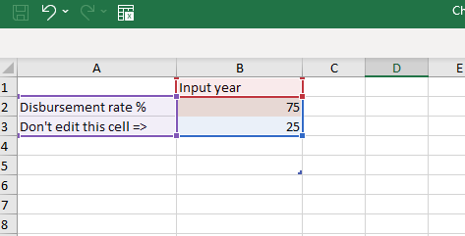
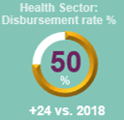
Editing values in doughnuts: disbursement example
Right click on the doughnut chart for the health sector (the doughnut on the left of the factsheet).
Select ‘Edit Data’. You’ll see this:
Change cell A2 to ‘Expenditure’ if you are tracking expenditure instead of disbursement.
Input the year under review in cell B1.
Add the disbursement rate into cell B2, shaded in orange.
Close the window.
In older PowerPoint versions, you may have to place the cursor on the little arrow beside ‘Edit Data’ and select Edit Data with Excel’

Slide 19
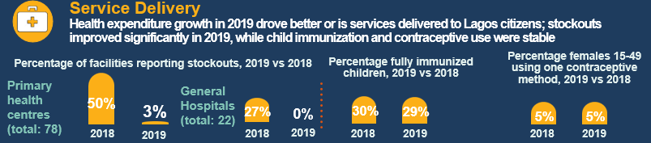
Service delivery section
This section shows the link between fund disbursement/expenditure and service delivery performance.
Did service delivery improve as a result of more funds being disbursed?
12. Add a sentence to explain the status of service delivery in your region.
13. Choose three service delivery indicators to track and change these headings accordingly.
14. Right click on each of the three bar charts and select ‘Edit Data’. Input your data on service delivery indicators for the two years in review. Change the years to reflect this.

Slide 20
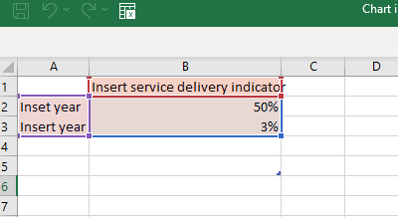
Editing bar charts: service delivery example
Select the bar graph (right click on one of the three charts in this section).
Select ‘Edit Data’. You’ll see this:
Add the years under review in cells A2 and A3.
Type in the service delivery indicator that you want to review in cell B1.
Add in the data for each year in cells B2 and B3.
Close the window and the chart will automatically update.
In older PowerPoint versions, you may have to place the cursor on the little arrow beside ‘Edit Data’ and select ‘Edit Data with Excel’

Slide 21
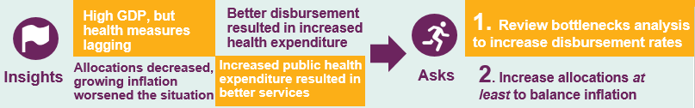
Insights and asks
Findings should be a repetition of the key points that the factsheet shows.
It is important to:
  make sure that anything mentioned as a ‘finding’ is included somewhere in the factsheet
  keep recommendations/asks/calls to action to one side
  keep this section factual, based on the evidence presented.
Insights should be informative.
15. Add four findings in the four boxes. Keep these really short and concise.

Slide 22
Insights and asks (continued)
Try to keep your asks linked to the factsheet, so there is a logical link between the findings presented and the asks.
Make your asks as SMART as possible, being clear who must take action and what they must do.
16. Add your two asks here.

Slide 23
The write-up (second page)
The write-up provides an opportunity to present the information in text, rather than figures.
Consistency is important: insights and the asks should reflect the evidence presented in the factsheet.
Try to keep the narrative concise, emphasising key points.
If you don’t want to include a narrative, you could consider sharing a story that ‘humanises’ your advocacy messages, demonstrating why funding for health matters.

Slide 24
Qualities of good advocacy messages
Insights and asks should be:
Clear: specific enough that there is no uncertainty (if increasing allocation, by how much?)
Concise: one sentence each
Compelling: addressing the target audience’s key concerns and values
Credible: the target audience should be able to complete the action.

Slide 25
Example
The following is a health budget advocacy brief developed by LASAM in Lagos, to make the case for improved funding for heath

Slide 26
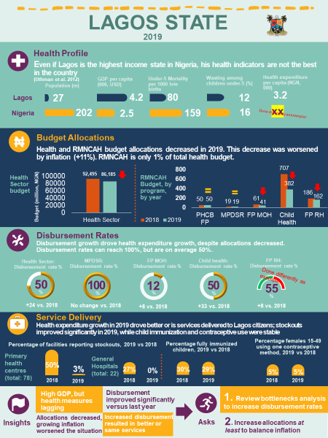

Slide 27

LAGOS STATE
2019
Lagos State is the richest state in the country, and its health indicators fare better than average Nigeria. However, even if Lagos is the richest state, his health indicators are not the best in the country (Uthman et al. 2012)
Health and RMNCAH budget allocations decreased in 2019 (health sector: -7%), and this decrease was worsened by inflation (+11% in 2019). Within the health sector budget (~9% of total Lagos state budget), RMNCAH is only 1%.
Disbursement rates increased in 2019 (health sector: +24%). This growth resulted in increased health expenditure, more than offsetting decreasing allocation, Disbursement rates can reach 100%, but are on average 50%. Budget execution rate is 100% (2019): every Naira given to the health sector is spent.
Increase health expenditure resulted in better services delivered to Lagos citizens; stockouts (months) of lifesaving commodities improved significantly in 2019, going to 0 in hospitals and close to 0 in Primary Health Centres.
Insight: investing in Lagos State health results in better services.
Insight: allocations and disbursement rates both show opportunities for improvement. However, in 2019l allocations decreased both in nominal and real value, while disbursement rates improved significantly
Ask: increase allocation at least to balance inflation
Ask: review bottlenecks to improve disbursement rates
Sources: for health data: population, GDP per capita: Lagos State government, 2015-2020; Under-5 mortality: Uthman et al., 2012, Wasting: Wollum et al 2015. For allocation and disbursement data: Lagos Budget Performance 2020. For service delivery data: E4A Scorecards, 2018-2019

Slide 28
Next steps
These slides are designed to help you to explore how to make the case for improved investment in health in your region.
These slides include step-by-step guidance on how to adapt the health budget advocacy brief for your own context. We recommend you use this guidance and the Health Budget Advocacy Brief tool, to develop your own.
This will provide you with an advocacy product to present to key policymakers to catalyse action.

