Slide 1


Using Advocacy Briefs to Package Evidence
A Guide to Coalition Building – Training slides

Slide 2
Objectives
To better understand the available tools to package data and evidence and when they might be most appropriate for use
To be equipped with the skills to develop effective advocacy briefs

Slide 3

Starting from your advocacy…
What objective are you trying to achieve?
Who is the target of your advocacy efforts?

Slide 4
Packaging Evidence
Once your objectives and target audience are clear the next step is to understand how best to package your evidence
Different stakeholders have different information needs
Important to know and understand these different needs to ensure relevant information is effectively communicated to the right stakeholder

Slide 5
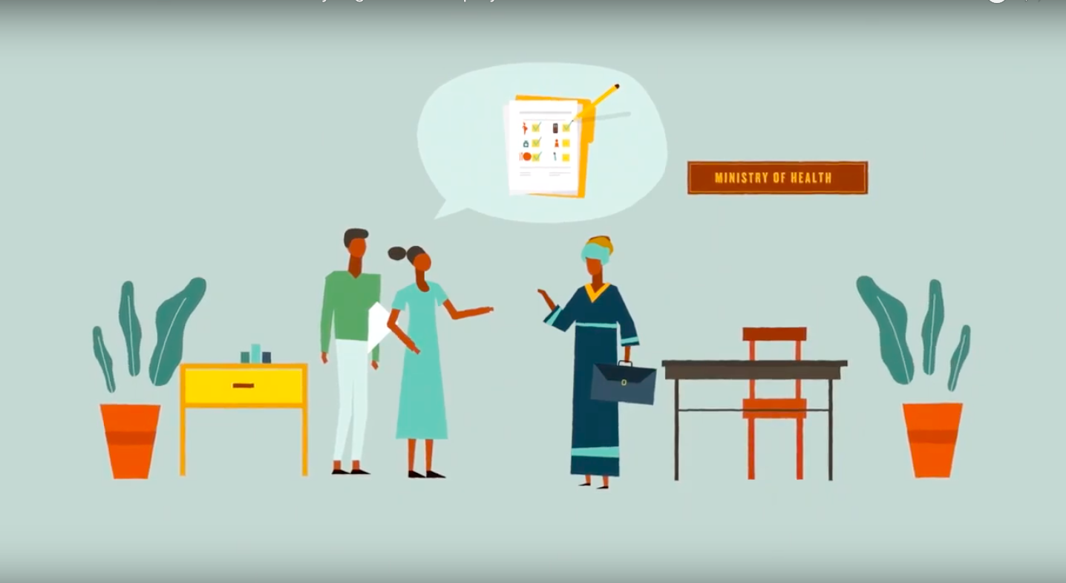
What is an advocacy brief?
Provides a concise summary of a particular issue (using evidence), the options to deal with it, and some recommendations on the best option
Advocacy briefs are key to capture priorities using evidence
Why is an evidence brief an important advocacy tool?
Notes:
An advocacy brief includes a concise summary of a particular issue, the options to deal with it, and some recommendations on the best option (Gillespie & Fredrick, 2013). It also provides decision-makers with the evidence to support that option. Because advocacy efforts focus on decision-makers who might have little relevant technical background or are busy and sometimes not aware of or interested in the topic, the following points should be kept in mind when developing briefs.
on your previous analysis of the decision-maker, select which is the most relevant tool.

Slide 6
Advocacy brief: key elements
Briefs should be:
Short. 1-2 pages (double-sided, usually about 700 words) is best, with key information on the front.
Focused. There should be only one or two take-home messages.
Evidence-based. But non-technical in presentation. Focus on meanings, not methods.
Relevant. Country- and, if possible, state- or district-specific.
An effective advocacy brief will:
Provide enough BACKGROUND for the policymaker to understand the problem.
CONVINCE the policymaker that solving the problem is important and urgent.
Provide EVIDENCE to support action.
Incite the policymaker to make a decision with a clear, actionable ASK.

Slide 7
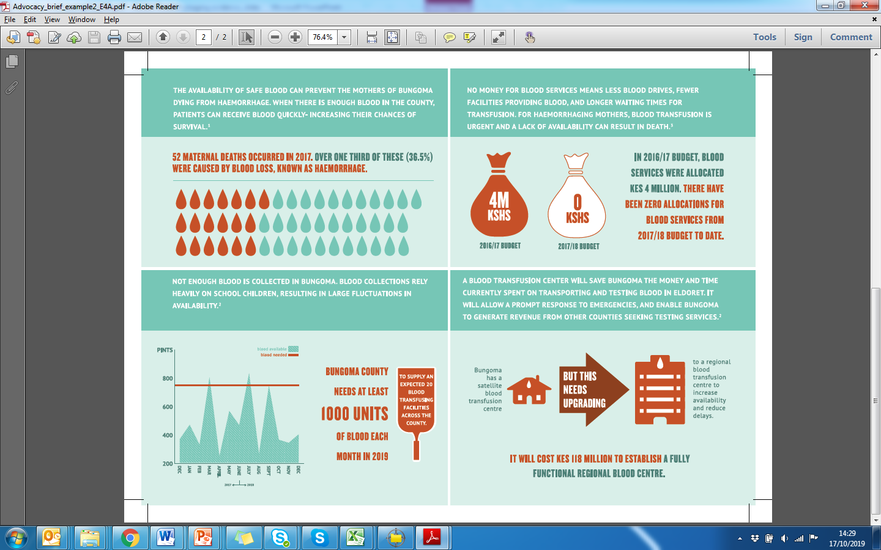
Notes:
Facilitator –

Slide 8
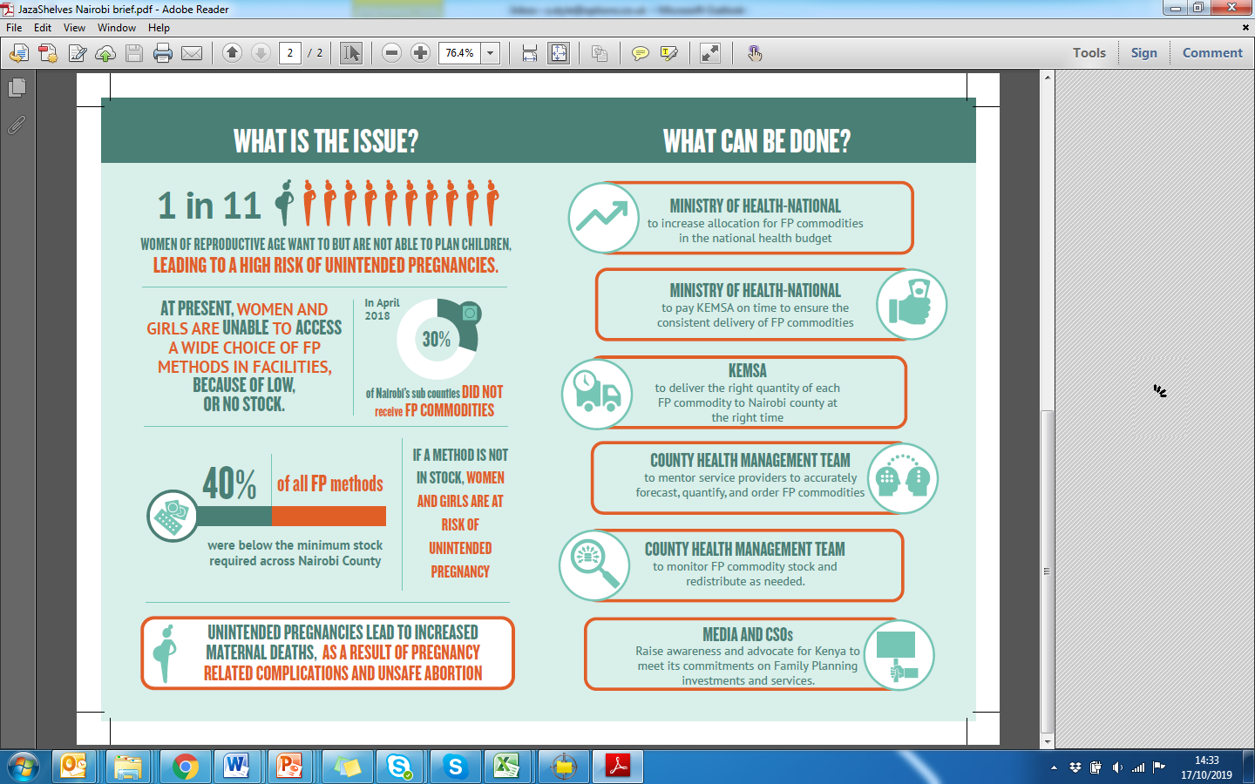

Slide 9
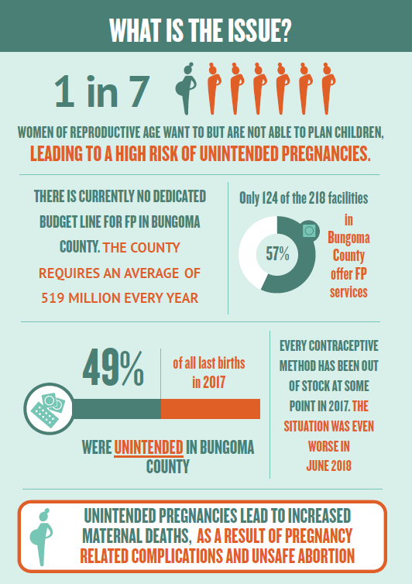
How do we use of evidence in a brief?
DATA
RELEVANT
GRAPHICS
(charts, figures etc.)
NON-
TECHNICAL
Notes:
Data that support or emphasize the main message are essential.
Present only information that is relevant to the decision-maker.
Use graphics such as charts, figures, and tables to show data visually, but make sure the graphics have clear titles and the message is easily discerned.
Define technical terms in a way that is understandable to the average reader.
Attribution
Provide references for evidence—but not so many that it begins to look like an academic report.
Make the organizational source of the brief clear through attribution or inclusion of a logo(s).
Include a “for further information” section along with the name of a person to contact.

Slide 10
Format & Style
Short, succinct sentences e.g. “unintended pregnancies lead to increased maternal death”.
Lay out your text in an electronic- and printer-friendly format.
Consider bulleted lists and tables, use boldface text to highlight important words or phrases, and insert subheadings to improve readability.
Select photos strategically to convey a message and put a “human face” on the topic.
Use boxes or sidebars to present various types of information that do not fit well in the flow of the text.
Notes:
Short, succinct sentences e.g. “unintended pregnancies lead to increased maternal death”
Use “white space” to make the page appealing to the eye and attention-catching.
Lay out your text in an electronic- and printer-friendly format.
Consider bulleted lists and tables, use boldface text to highlight important words or phrases, and insert subheadings to improve readability.
Select photos strategically to convey a message and put a “human face” on the topic, as well as to make the page attractive. However, be cautious of adding too many images, which can make the file size large and affect download speed.
Use boxes or sidebars to present various types of information that do not fit well in the flow of the text.

Slide 11

Tip!
Your advocacy and use of evidence briefs should be audience specific.
We should be clear on what is our policy suggestion to inform decision making.

Slide 12

Who should we target with our advocacy briefs?
What is the purpose of our advocacy briefs?
When do we see opportunities to present advocacy briefs?
Which platforms/avenues exist for us to present advocacy briefs?

Slide 13

Who will play what role in developing the briefs?
The coalition to develop a roadmap that marks key timelines of when they will be presenting evidence briefs to decision makers. They should also outline clearly in an organised structure who amongst its membership will play what role.
Hint: Consider having a sub-committees: Evidence, Advocacy communications etc

