Slide 1


Why Advocacy Matters?
A Guide to Coalition Building – Training slides

Slide 2
What are the objectives of the session?
1
Define key terms in relation to advocacy
Explain the linkage between Accountability and Advocacy
Describe why advocacy is important
2
3

Slide 3
Definitions

Slide 4
Definition of terms
Advocacy is the deliberate process of influencing those who make decisions about developing, changing and implementing decisions.
Advocacy is not
  Information, Education and Communication
  Informing the government about your organization
  Raising public awareness about your organization
Advocates are people-oriented. They act on behalf of other people and represent the concerns of communities.
Notes:
Advocacy:
What does deliberate process mean? involving intentional actions
What does influencing look like? Advocacy is about influencing those who make policy decisions
What does developing changing and implementing policies mean?
Often policies are outdated, or non-existent or deliberately block what we want to achieve so legislative changes are required
Policies could be perfect on paper but are not being implemented.
Advocacy is not
Information, Education and Communication
Informing the government about your organization
Raising public awareness about your organization

Slide 5
Definition of terms (2)
Lobbying: it occurs when someone seeks to influence legislation. is always advocacy, but advocacy is not always lobbying
Activists: individuals who support a campaign to cause social and/or political change
Accountability: the obligation of power-holders to account for or take responsibility for their actions
Strategy: a shared plan that tells us what change we would like to achieve and how we will achieve it
Notes:
Advocacy:
What does deliberate process mean? involving intentional actions
What does influencing look like? Advocacy is about influencing those who make policy decisions
What does developing changing and implementing policies mean?
Often policies are outdated, or non-existent or deliberately block what we want to achieve so legislative changes are required
Policies could be perfect on paper but are not being implemented.
Advocacy is not
Information, Education and Communication
Informing the government about your organization
Raising public awareness about your organization

Slide 6
Accountability and Advocacy

Slide 7
Elements of Accountability
Accountability
Fundamental principle of democracy is that citizens have the right to demand accountability and public actors have an obligation to account
It is required to keep the public sector transparent and productive
Consequence of the implicit ‘social compact’ between citizens and their delegated representatives and agents of government
Agreement for mutual benefit of government and citizens, outlining the responsibilities and obligations and what is expected from both sides of the divide

Slide 8
Types of accountability
Horizontal
State institutions are able to hold to account its own branches of government
Vertical
State’s population to hold its government accountable
Social
Ordinary citizens and/or CSOs participate directly or indirectly in exacting accountability

Slide 9
Why is advocacy important?

Slide 10
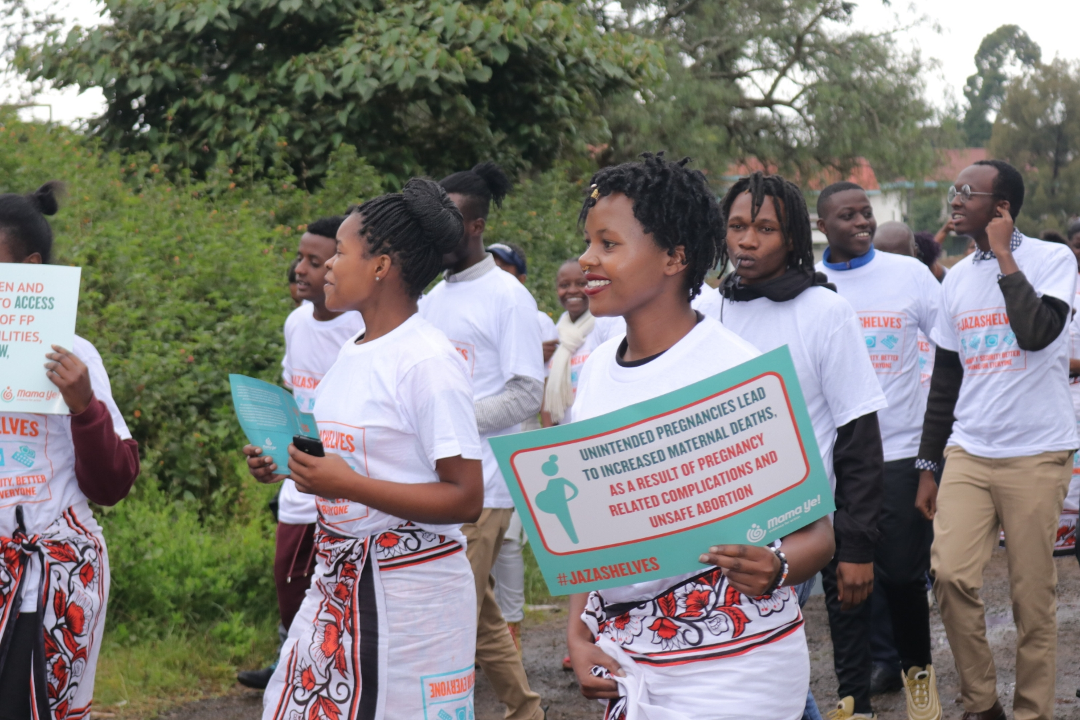
Importance of Advocacy
  The aim of advocacy is to influence decision makers at different levels.

Slide 11
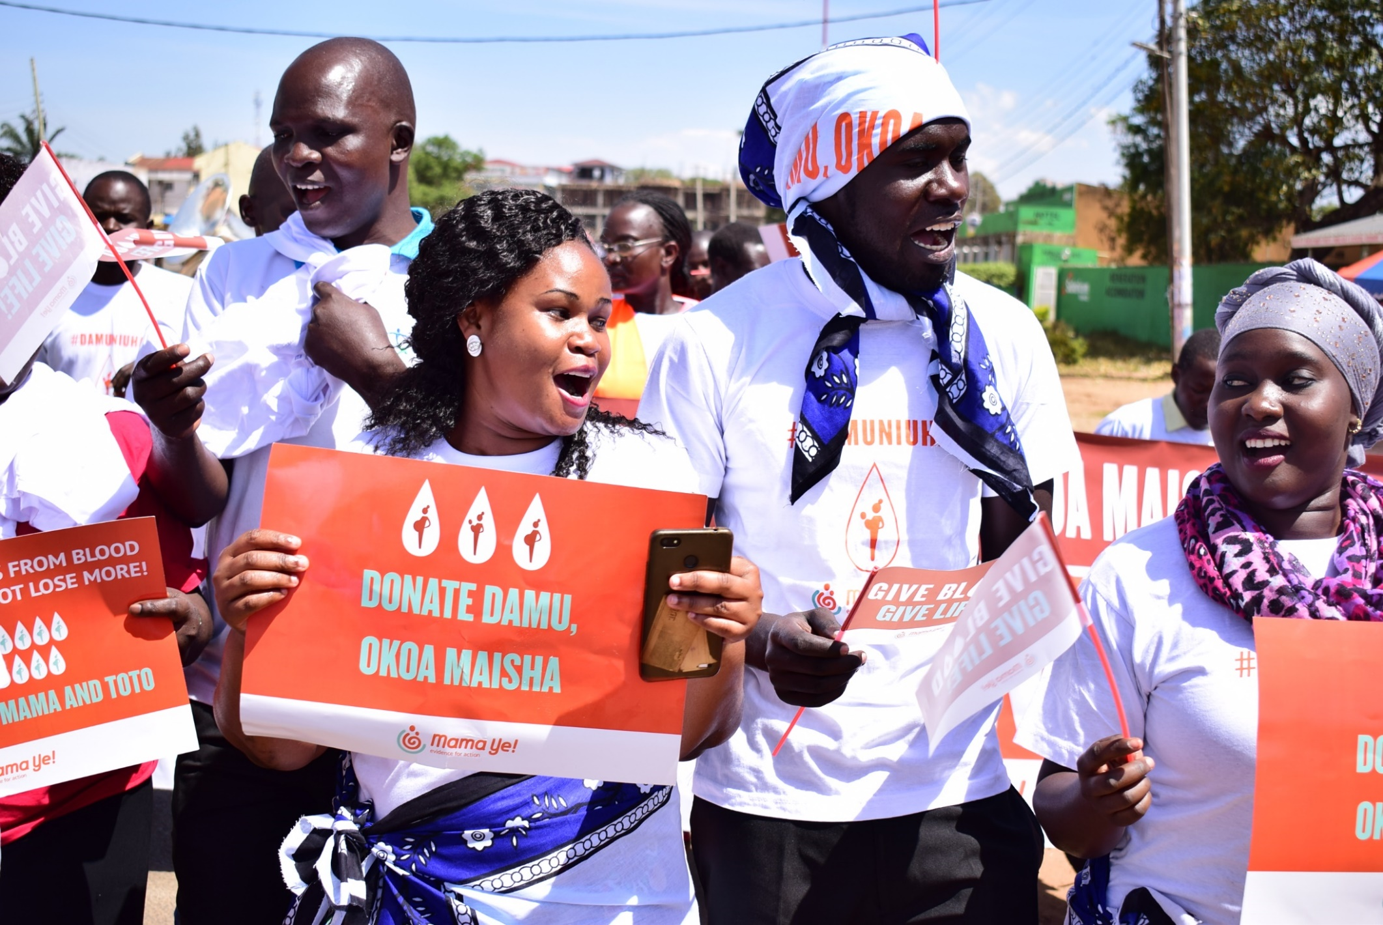
Rationale for Advocacy
  Advocacy matters because it can bring about structural changes.

Slide 12
What are the key messages to takeaway from this session?
Advocacy
  Is deliberate
  Involves influencing those who make decisions
  Is about developing, changing and implementing policies.
Advocacy is effective when three key ingredients are in place
  Understanding of context
  Evidence of problem
  Feasibility of action

Slide 13
What makes Advocacy Effective
Good advocacy
Context
Evidence
Feasibility

Slide 14

Example of where Advocacy for MNH has been successful (1)
Case study : Advocacy for free maternal and child health care in Nigeria
Study to determine the outcome of an advocacy program aimed at implementing a policy of free maternal and child health (MCH) services in Nigeria.
What was done?
Situational analysis on costing of MCH services done + public health education and advocacy.
Advocacy consisted of public presentation on MCH to high-level policymakers, dissemination of situational analysis report, and media publicity.
The implementation of free MCH services at national and sub-national levels assessed after 3 years.
What were the results?
Increase in # of states offering comprehensive free MCH services from 4 to 9;
States offering partially free MCH services increased from 11 to 14
Those not offering any form of free treatment decreased from 22 to 14

Slide 15
Example of where Advocacy for MNH has been successful (2)
Advocacy Success Story: Kenya Approves Misoprostol for PPH
Inclusion of misoprostol in the the Kenya Essential Medicines List 2016 (KEML)
  Used for the prevention and treatment of postpartum hemorrhage (PPH), excessive bleeding after childbirth. This is a leading cause of maternal death
How was it done?
  Bringing the right people to the table
  Advocate at just the right time!
  Point to the evidence
  Advocate strategically
What were the results?
Inclusion of misoprostol as a maternal health medicine on the KEML, a necessary step to expand access to this life-saving medicine;

Slide 16
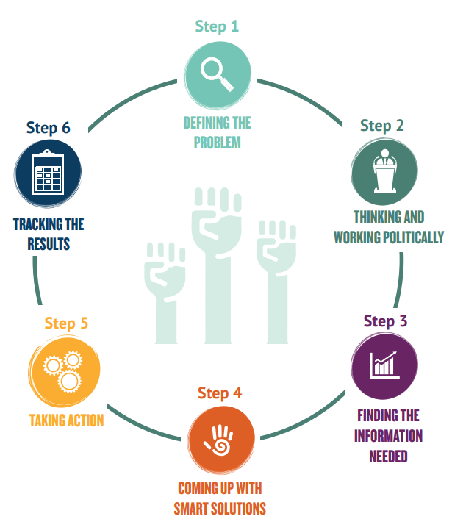
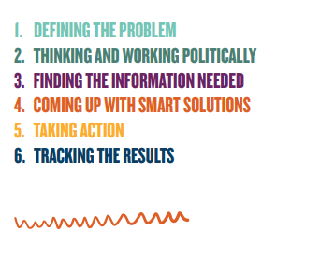
6 step approach to advocacy
  Head to our website to find out more on each step!
Notes:
Our training follows a 9-step approach to advocacy. For the remaining part of this training we shall take CSOs through each stage: supporting them to determine the problem; agree the change; source the evidence; and advocate effectively. This is the first advocacy training delivered to these organisations; and will be followed up with deeper dives into subjects such as budget analysis and communications.

